Slide 1
MOPD Disaster Network
Quarterly Meeting: May 28th 2019
100 Gold St 2nd Floor, NY 10:00AM to 12:00PM

Slide 2
Agenda
Welcome:
Eli Fresquez (MOPD)
Partnership for Inclusive Disaster Strategies:
Marcie Roth, CEO (Former Director, Office of Disability Integration & Coordination FEMA)
NYC Heat Plan & Health Impacts:
Chris Pagnotta (NYCEM) & Munerah Ahmed (DOHMH)
Pets & Service Animals During Disasters:
Andy Perlman (NYCEM)
Open Discussion and Next Meeting

Slide 3

Disability Inclusion Before, During and After Disasters
Marcie Roth
CEO, Partnership for Inclusive Disaster Strategies
(301) 717-7447
marcie@disasterstrategies.org
www.disasterstrategies.org
www.reaadi.com

Slide 4
Partnership for Inclusive Disaster Strategies
The Partnership for Inclusive Disaster Strategies (the Partnership) represents 64 million Americans with disabilities in every congressional district and virtually every community across the US.
We are the only organization in the US with a mission that focuses exclusively on disability and disaster.
We also lead global disability and disaster initiatives through our work with the United Nations Office for Disaster Risk Reduction.

Slide 5
Partnership Mission
The mission of the Partnership is equal access to emergency programs and services and full inclusion of the whole community before, during and after disasters.
We achieve our mission through:
*Unwavering support for local disability organizations *Community engagement, organizing and leadership development *Advocacy and public policy *Training and education *Research and technical assistance

Slide 6
Partnership Services
Disaster Hotline (800) 962-9629 - 24/7
Disaster Accessibility Response Team
Disaster Response Daily Teleconference Coordination
Legislative and Policy Initiatives
Getting it Right Conferences
Weekly National Stakeholder Teleconferences
On-site and Remote Training and Technical Assistance
Newsletter
Publications

Slide 7
Partnership Recent Publications
Preserving Our Freedom: Ending Institutionalization of People with Disabilities During and After Disasters. National Council on Disability. https://ncd.gov/publications/2019/preserving-our-freedom
Inclusive Disaster Risk Reduction- A Whole Community Action. United Nations Economic and Social Commission for Asia and the Pacific. https://www.maketherightreal.net/learning
Getting It Wrong: An Indictment with a Blueprint for Getting It Right Disability Rights, Obligations and Responsibilities Before, During and After Disasters. http://www.disasterstrategies.org/index.php/news/partnership-releases-2017-2018-after-action-report

Slide 8

REAADI in Disasters Act

Slide 9
The REAADI In Disasters Act
Address federal disaster funding in compliance with disability civil rights laws.
Create Training, Technical Assistance and Research Centers for disability inclusive emergency preparedness and disaster response, recovery and mitigation.
Establish a National Commission on Disability Rights and Disasters.
Review all DOJ Project Civic Access Settlement Agreements.
Require a GAO investigation of all federal funds since hurricane Katrina to ensure compliance.

Slide 10
The Disaster Relief Medicaid Act
Ensures that individuals eligible for Medicaid who are forced to relocate to another state due to a disaster are able to continue to access their Medicaid supported services.
Provides states with resources to support the Medicaid needs of individuals forced to relocate through:
a limited time one hundred percent federal match for displaced individuals
technical assistance
support to develop innovative state strategies to respond to an influx of out-of-state individuals
Creates a grant to help states develop an emergency response corps to provide home and community-based services.
Guarantees that a 100 percent federal matching payment for medical assistance is provided to states in disaster areas.

Slide 11

Disaster Resilience & Resource Network
MOPD Summer Updates
Network Resources
Twitter Alt Text

Slide 12

NYC Heat Emergency Plan

Slide 13
Heat Emergency Plan Triggers
Activation Criteria
Predicted Heat Index of 100 F or higher for one day or more
-- OR --
Predicted Heat Index of 95 F or higher at any point for two consecutive days or more

Slide 14
Heat Emergency Plan Objectives
Objective 1: Provide Hazard Awareness and Disseminate Public Messaging
Objective 2: Minimize Impacts to the Public Health System
Objective 3: Minimize Impacts to Infrastructure

Slide 15
Heat Emergency Plan Objectives -- Cont’d --
Objective 1:
Provide Hazard Awareness and Disseminate Public Messaging

Slide 16

Heat Emergency Plan Objectives -- Cont’d --
Operational Strategy 1.1: Disseminate Public Information
Notify NYC
Traditional media
Beat the Heat campaign
Outreach to communities, elected officials
NYC Advance Warning System

Slide 17
Heat Emergency Plan Objectives -- Cont’d --
Objective 2:
Minimize Impacts to Public Health

Slide 18
Heat Emergency Plan Objectives -- Cont’d --
Operational Strategy 2.1: Activate the Advance Warning System
Heat alerts are delivered via e-mail to agencies and organizations that have developed trusted relationships with their clients
Agencies and organizations can tailor communication and support to their client’s specific needs
1,900 + Organizations
Conference calls are held with umbrella service agencies

Slide 19
Heat Emergency Plan Objectives -- Cont’d --
Operational Strategy 2.2: Activate Cooling Centers
Operate during daytime hours
Free and open to the public, air-conditioned facilities
Libraries, Senior Centers, Recreation Centers
Run by 8 partner agencies: NYPL, QPL, BPL, DFTA, DYCD, NYCHA, Parks, Salvation Army
577 facilities available for summer of 2019. People can find their nearest location through 311 or the Cooling Center finder

Slide 20


Heat Emergency Plan Objectives -- Cont’d --
Operational Strategy 2.3: Conduct Homeless Outreach
Focus on priority list of clients at high risk for heat-related illness
Homeless Services increase checks, especially during sun’s peak hours 1100-1600 hours

Slide 21
Heat Emergency Plan Objectives -- Cont’d --
Objective 3:
Minimize Impacts to Infrastructure

Slide 22


Heat Emergency Plan Objectives -- Cont’d --
Operational Strategy 3.1: Relieve Stress on Electric System
Con Ed & PSE&G-LI proactively reduce the load on the electric system to prevent localized or widespread power outages
This may include:
Customer Appeals
Peak Load Management
Demand Response Programs

Slide 23

Heat Emergency Plan Objectives -- Cont’d --
Operational Strategy 3.2: Issue Excavation Safety Alert
NYC issues an Excavation Safety Alert (ESA) during heat emergencies
Heightens awareness of safe excavation practices to protect the integrity of the underground critical facilities

Slide 24

Heat Emergency Plan Objectives -- Cont’d --
Operational Strategy 3.3: Distribute Spray Caps
FDNY distributes hydrant spray caps to the public
Applicants complete request form from FDNY firehouses
Fire hydrants are often illegally opened and used as sprinklers creating drops in system water pressure

Slide 25
Heat Health Risks in NYC: Protecting At-Risk Populations MOPD Disaster Network May 28, 2019
Munerah Ahmed, MPH
Bureau Environmental Surveillance and Policy
Division of Environmental Health

Slide 26
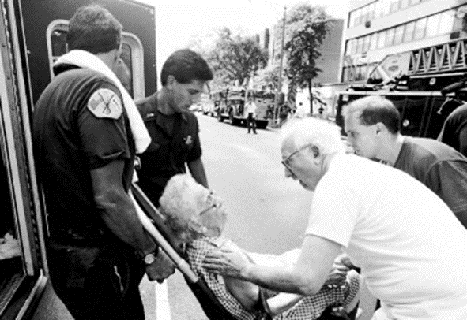
Dangers of Hot Weather & Heat Waves
Deadliest extreme weather event in NYC and nation
Examples of severe heat waves
1995 Chicago: ~750 deaths
2003 France: >10,000 deaths
2015 India: ~2,500 deaths
http://www.chicagotribune.com/news/nationworld/politics/chi-chicagodays-1995heat-story-story.html

Slide 27
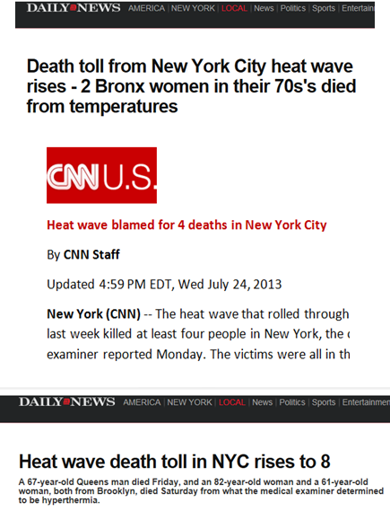
Health Impacts in NYC
Summer averages
13 heat stroke deaths
115 excess natural cause deaths
450 heat-related emergency room visits
150 hospital admissions
2006 10-day heat wave
160 deaths
Among the hottest heat waves in NYC

Slide 28
Heat and Health
Heat-specific illness
Heat stroke/hyperthermia (medical emergency!)
Heat exhaustion
Heat cramps
Exacerbation of chronic health conditions
ED visits, hospital admissions and deaths

Slide 29

Signs of Heat Stroke
Call 911 immediately if someone you know shows these symptoms
Hot, dry skin
Confusion, hallucinations, disorientation
Unconsciousness or unresponsiveness
Nausea or vomiting
Trouble breathing
Rapid, strong pulse
Weakness, dizziness
http://www.nydailynews.com/new-york/19-dead-new-york-city-scorching-summer-heat-wave-article-1.956823

Slide 30
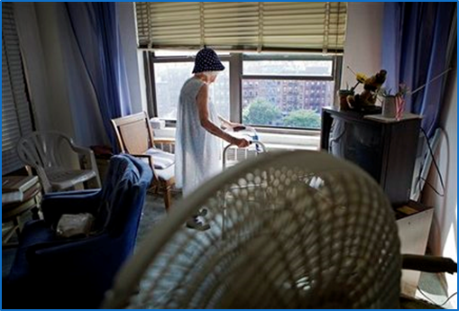
Indoor Risk
85% (41) hyperthermia deaths occurred after exposure to heat in hot home (2008-2011)
88% (23) no AC
12% (3) broken AC or not in use
Comorbid conditions
CVD 55%
Diabetes 13%
Substance abuse 11%
Mental health conditions
Homes without air conditioning can be significantly hotter than outside, especially at night
Source: MMWR August 9, 2013 / 62(31);617-621

Slide 31
Who Is Most Vulnerable?
Those who do not use/have air conditioning AND:
Chronic health conditions
Cardiovascular, respiratory, or renal disease
Obesity (BMI > 30)
Diabetes
Psychiatric illness such as schizophrenia or bipolar disorder
Cognitive or developmental disorder that impairs judgment or self-care
Have trouble responding to heat or use medicines that impair that ability
Illicit drug or heavy alcohol use
Socially isolated or with limited mobility
Higher prevalence in Older New Yorkers & Black New Yorkers

Slide 32
Medicines and Ability to Stay Safe
Increase risk for dehydration
Impair ability to sweat
Decrease heart rate
Increase body temperature
Reduce alertness, judgment or awareness of heat
Examples of drugs
Diuretics: Diuril, Microzide
Psychotropics: lithium, or Zoloft
Anticholinergics: Benadryl, Parkinson’s medicine
High blood pressure medicines: beta blockers

Slide 33

Air Conditioning Saves Lives
AC most effective way to prevent heat illness and death
Set AC to 78° or low cool to be safe, comfortable and save money
Or go to a cool place like a cooling center, library, a friend or neighbor’s house
You or your clients can call 311 or www.nyc.gov/beattheheat to find nearby cooling centers during a heat wave

Slide 34
Home Air Conditioning Assistance
Limited amount of HEAP funding available for AC purchase & installation
Income requirement
Documentation of a medical need
Available from May 1
Until funds spent or August
Excludes those living in public housing or receiving federal housing subsidies
-- Call 311 or https://www1.nyc.gov/site/hra/help/energy-assistance.page for more info

Slide 35
2018-19 HEAP Monthly Income Guidelines
Household Size | Maximum Gross Monthly Income
1 | $2,391
2 | $3,127
3 | $3,863
4 | $4,598
5 | $5,334
6 | $6,070
7 | $6,208

Slide 36
Help Your Clients Get Ready for Summer
Before it gets hot
Flag clients at highest risk
Which clients do NOT have AC?
Which clients have a health risk factor?
Inform them how to avoid heat illness
Create a heat emergency plan
During heat emergencies
Activate your plan
Encourage friends, family & neighbors to frequently check on them
After heat emergencies
Review actions: what worked and what didn’t
Apply lessons learned

Slide 37
Health and Power Outages
Power outages may be a concern because a client:
May find it difficult to stay cool during very hot weather
May not be able to use electrically-powered life sustaining equipment such as a respirator or dialysis machine
Know if clients use life-sustaining medical equipment
Help your clients register with utilities to be contacted if power problems are expected
Depending on your utility provider, other programs may be available for extra time to pay the utility bill due to medical conditions
Have an alternate or back-up source of electric power, such as a battery back-up

Slide 38

Heat Illness Prevention: Be a Buddy
Check in on high-risk clients during heat waves – you may be their only buddy
Encourage them to use their AC, even if only for a few hours
If no AC, help to find a cool place they can go. Call 311 for nearest NYC Cooling Center which are open during heat waves.
Fans alone are not enough
Watch out for symptoms and signs of heat illness

Slide 39
More Information and Resources
For heat safety information, brochures and a checklist to help you prepare clients for heat waves, visit: www.nyc.gov/health/heat or go to www.nyc.gov and search for “heat illness”
Call 311 or visit www.nyc.gov/beattheheat more information on cooling center locations and other heat preparedness tips
Sign up to Notify NYC for personalized alerts: nyc.gov/notifynyc
Sign up to the NYC Advance Warning System for alerts for Service Providers: advancewarningsystemnyc.org

Slide 40

THANK YOU! Questions?
mahmed4@health.nyc.gov

Slide 41

NYC Emergency Management Community Preparedness

Slide 42

Extreme Heat Webinar
Date: Wednesday, June 12 Time: 12PM - 1PM
For registration, reasonable accommodations or other auxiliary aids and/or services, please email communityprep@oem.nyc.gov

Slide 43
New York city emergency management (nycem) Pets & Service Animals in Disasters MOPD Disaster Network Neeting May 28, 2019
Andrew J. Perlman Program Manager, Human Services

Slide 44




Agenda
Service Animals vs. Emotional Support Animals
NYC Emergency Shelters
Public Planning
NYCEM Planning

Slide 45


Service Animals vs. Emotional Support Animals (ESA)
Service Animal: A dog that is individually trained to do work or perform tasks for a person with a disability
Emotional Support Animal: A companion animal that provides therapeutic benefit to an individual with a mental or psychiatric disability
Therapy Dog: A dog who accompanies the handler to provide therapy in settings such as schools, hospitals, and nursing homes

Slide 46
Service Dogs
Rights:
Covered under ADA.
Permitted in all areas of public accommodation and all entities covered by ADA
Examples:
Hearing dog for individual who is Deaf
Dog trained to get handler to a safe location during PTSD-induced panic attack
Dog trained to alert handler with epilepsy of pending seizure and summon human assistance
Dog trained to open doors or retrieve objects for wheelchair user
Guide dog for someone who is visually impaired

Slide 47
Service Dogs
Allowable Questions:
Staff may ask two questions:
(1) is the dog a service animal required because of a disability?
(2) what work or task has the dog been trained to perform?
Training is key
Providing comfort is not something that requires training
Unallowable Questions and Requirements:
Documentation
Visual identification
Demonstration

Slide 48
Service Dogs
Expected Behavior:
Dog must be under the handler’s control at all times and must not cause a disruption or safety concern
Handler may be asked to remove dog from premises if not brought back under handler’s control or if causing a disruption or safety hazard.
Exclusions:
Out of control
Fundamentally alter the nature
Religious organizations (State)
Airlines

Slide 49

Emotional Support Animals (ESA)
Rights:
Covered under Fair Housing Act (FHA)
Landlord or other housing provider may request specific medical documentation from a medical or mental health provider

Slide 50
Summary
Emotional Support Animals:
Covered under FHA
Not limited to any specific type of animal
Detailed documentation may be requested
Generally, only permitted in residence
No specific training needed ***
Service Dogs:
Covered under ADA
Defined as only dogs
Two questions permitted
Permitted in any location covered by the ADA
Must be specifically trained

Slide 51
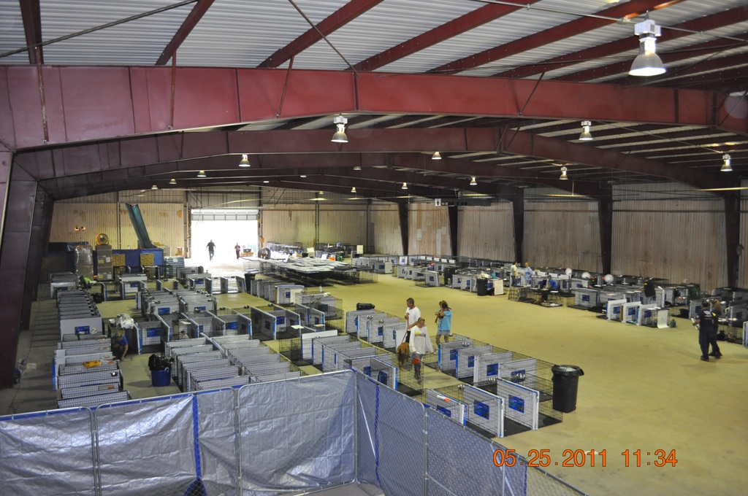
NYC Emergency Shelters
Pet friendly
Supplies
70,000 x 7 6,000 pallets 15,000 x 7
Care and feeding
Dormitory vs. separate area
Emergency Animal Shelter

Slide 52
Public Planning
Go Bags, harnesses, leashes, vaccination records, practice
Ready NYC
Advance Warning System (AWS)

Slide 53
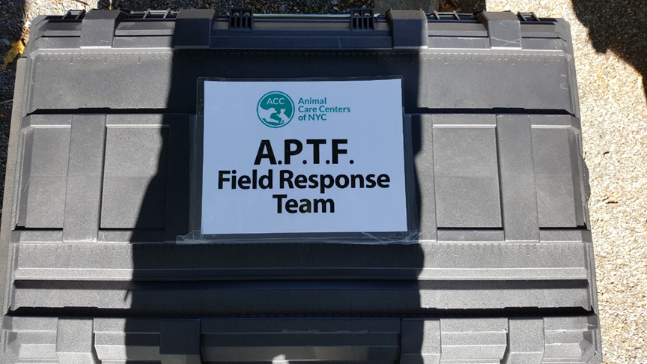
NYCEM Planning
Animal Planning Task Force (APTF)

Slide 54
Resources
ADA Requirements - Service Animals
ada.gov/service_animals_2010.htm

Slide 55
Questions?
Andy Perlman
Program Manager, Human Services
NYC Emergency Management
aperlman@oem.nyc.gov
718-422-8851

Slide 56
Thank You
Eli Fresquez
jfresquez@cityhall.nyc.gov
212-788-2505
MOPD_DSF@cityhall.nyc.gov
212-788-2548

