Slide 1
Housing Search Workshop
Emergency Housing Vouchers
Section 8
NYC HPD Division of Tenant Resources
Notes:
1

Slide 2
Introduction & Workshop Expectations
Housing Preservation and Development
Division of Tenant Resources
2
Notes:
Good morning, everyone, my name is Shameka Mayfield
I work with HPD, one of the New York City agencies that administer rental assistance programs. HPD works closely with NYCHA to administer the Emergency Housing Voucher program.
For today's session, I just ask that you remain muted so that we can limit any background noise and make it easier for everyone to hear. If you have questions throughout the workshop, you can "raise your hand" or type your questions in the chat.
The workshop today will be interactive, so there will be lots of opportunities for everyone to share. But at the end, we will also leave time for any questions you may have. We will also have contact information at the end.
2

Slide 3
Goals for Today’s Workshop
You’re getting ready to start your housing search.
Today we’re going to:
Review important details about your Emergency Housing Voucher that will impact your search
Talk about challenges of the housing search process and identify the resources to support you with your search
NYC HPD Division of Tenant Resources
3
Notes:
(Say Before Slide) Some of this information may be a review, but I want to discuss the goals for Today’s workshop.
SMALL PAUSE
3

Slide 4
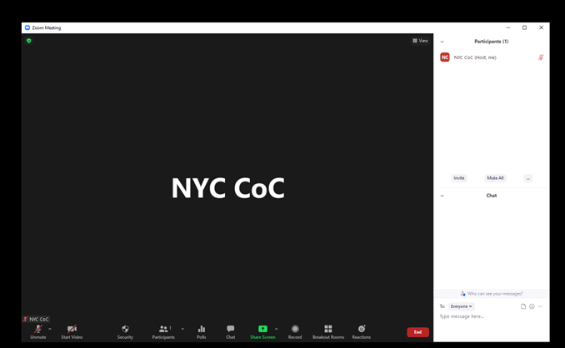
Technology Check
4
Notes:
(Say Before Slide) For those of you who may not be familiar with Zoom, I want to briefly go over how to use all of the functions.
If you are on a computer, your screen should look like this
On the bottom of the screen are the different options.
To mute or unmute your microphone, click the first button that says "Unmute"
If you want to turn your video ON or OFF, click the second button that says "Start Video"
If you want to view the chat, where you can write a message to the group, click the middle button that says "Chat"
4

Slide 5
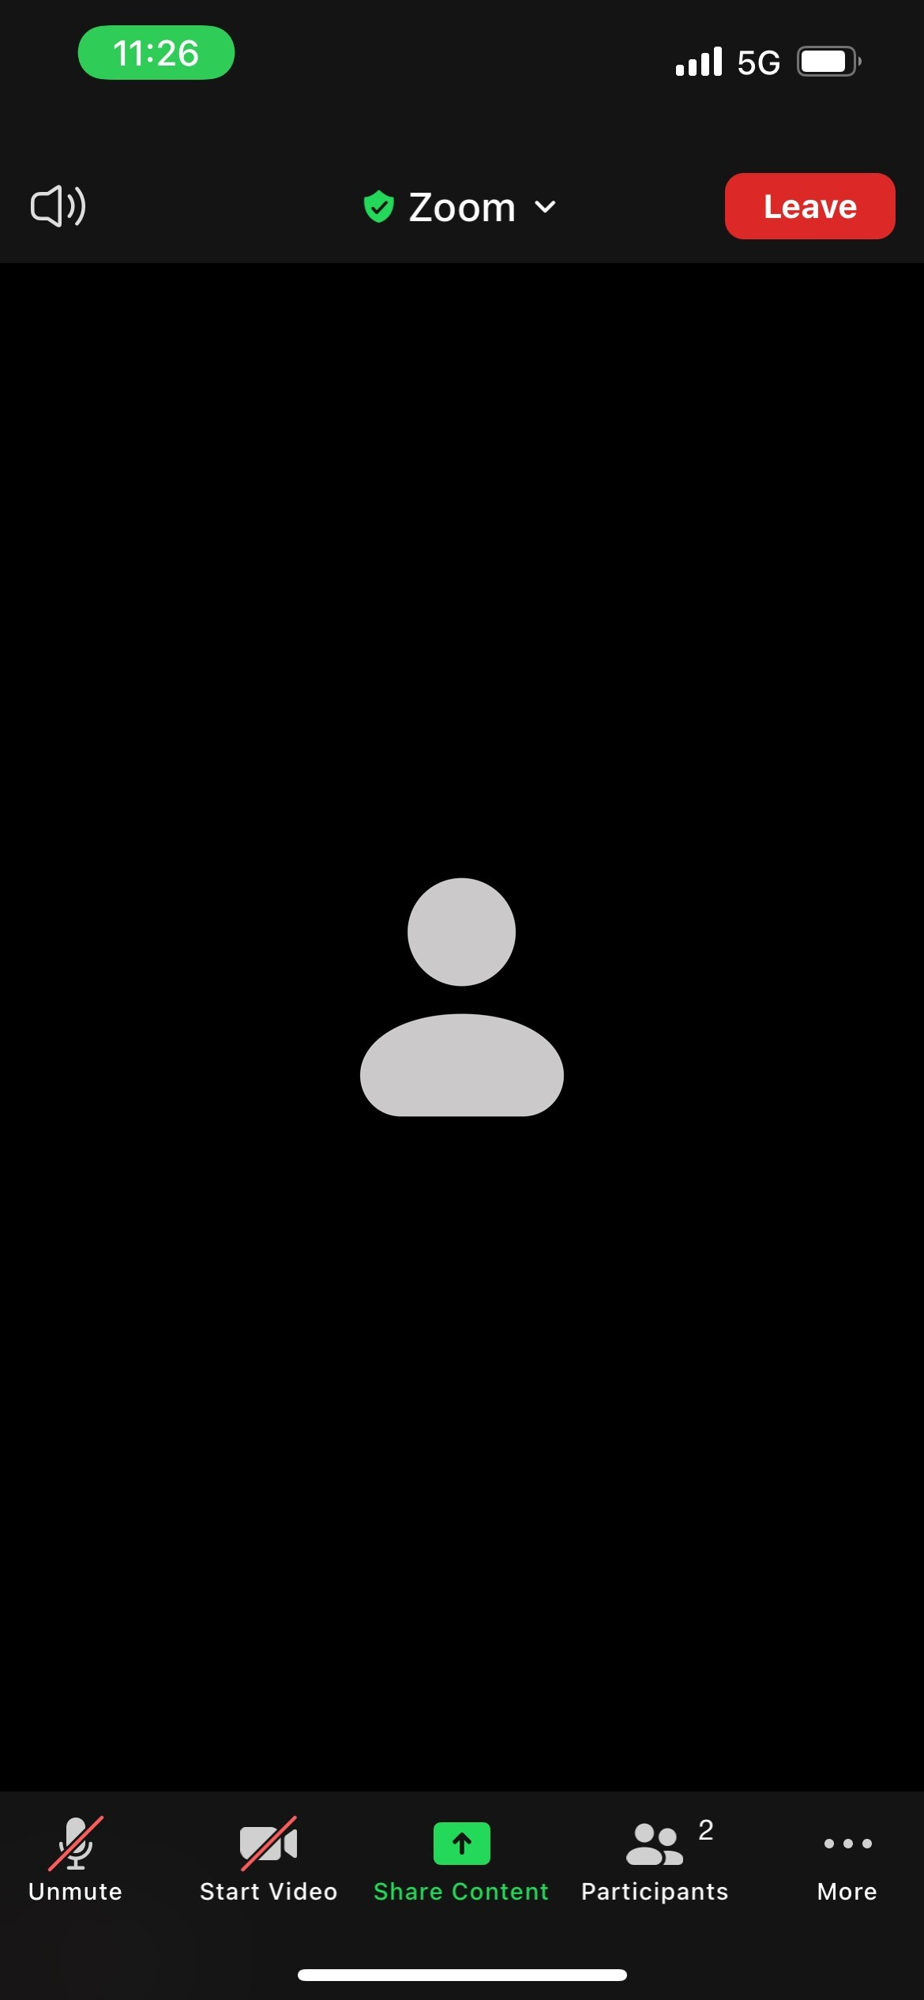
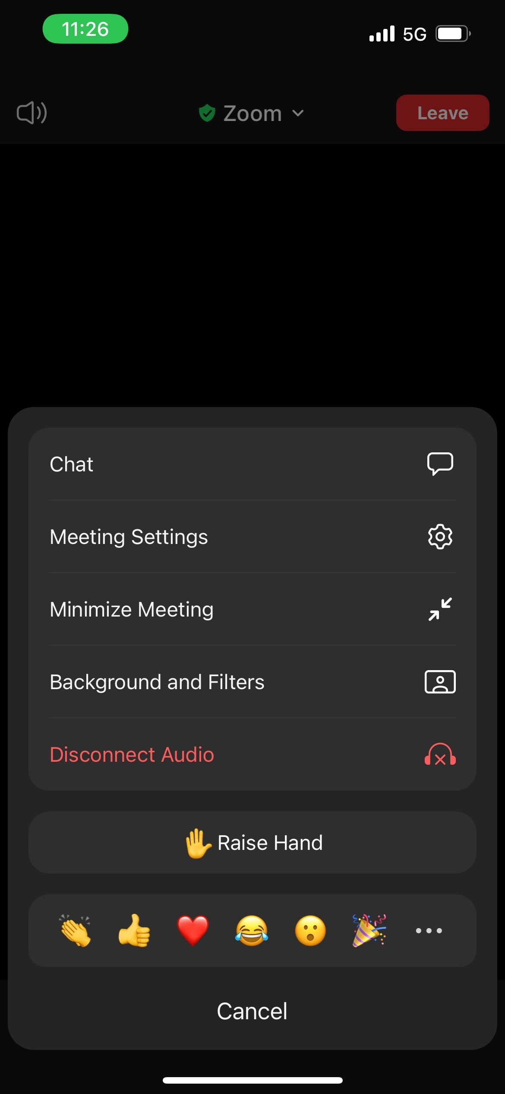
5
Notes:
(Before Slide) If you are using your phone, your screen will look like this
You have the mute/unmute button at the bottom, as well as the video button to turn your camera on.
To view the chat, you can click the three dots that say "More"
That will bring up a little menu where you can click on the Chat. You can also "Raise Hand" if you have a question.
Can we practice raising our hands or typing in the chat now?
BIG PAUSE
5

Slide 6
What are Emergency Housing Vouchers (EHVs)?
NYC HPD Division of Tenant Resources
6
Notes:
(Say Before Slide)
You have already viewed a briefing video that gave you a lot of information about the program and your voucher, but we want to make sure you come away today feeling confident about the most important parts of your voucher, and what resources are available to you to find an apartment.
Your Emergency Housing Voucher is similar to other Section 8 vouchers but different in a few ways that we’ll discuss.
6

Slide 7
What are EHVs?
EHVs were created as part of the American Rescue Plan Act to help households access housing as we recover from the COVID-19 pandemic
In New York City, the EHV program is run by both HPD and NYCHA
With the voucher, you will pay about 30% of your monthly income toward rent. HPD/NYCHA will pay the rest of the rent directly to the landlord
You will have 180 days to find an apartment
NYC HPD Division of Tenant Resources
7
Notes:
Talking points to include:
HPD and NYCHA both give each voucher holder 180 days 6 months to find housing.
7

Slide 8
What are EHVs?
EHVs may also be referred to as Section 8. There are some differences from the regular Section 8 program.
With an EHV, the City will pay for the security deposit and a broker fee. You may also work with a housing navigator to assist.
Receiving an EHV is not guarantee housing. You still need to find an apartment to rent and fill out all the required paperwork.
NYC HPD Division of Tenant Resources
8
Notes:
It’s important to find housing within the time you have on the voucher, we will talk today about what needs to get done.
8

Slide 9
Payment Standards
EHVs, like all Section 8 vouchers, have a maximum amount NYCHA or HPD can pay called the “payment standard”.
The payment standard depends on:
The number of allowed bedrooms
The ZIP Code
Whether utilities are included in the rent
The payment standard is higher in certain high-cost neighborhoods. These are called “exception payment standards” (EPS).
NYC HPD Division of Tenant Resources
9
Notes:
I will show you later in the presentation how to understand what payment standard applies to the unit you’re interested in
9

Slide 10
Key terms and abbreviations
PHA
HPD/NYCHA
EHVs
EPS
NYC HPD Division of Tenant Resources
10
Notes:
You may hear or see these terms, so we want to make sure you know what they are referring to.
PHA means Public Housing Authority. These are agencies that receive money from the US government to run Section 8 programs.
PHAs can include HPD and NYCHA. HPD is the Department of Housing Preservation and Development. NYCHA is the New York City Housing Authority. Both of these PHAs run the Emergency Housing Voucher program.
The Emergency Housing Voucher program may be shortened to EHV.
We will also talk more about EPS, which are Exception Payment Standards. These refer to the amount that the PHA will pay for each unit in certain areas of the city.
PAUSE: ARE THERE ANY QUESTIONS?
10

Slide 11
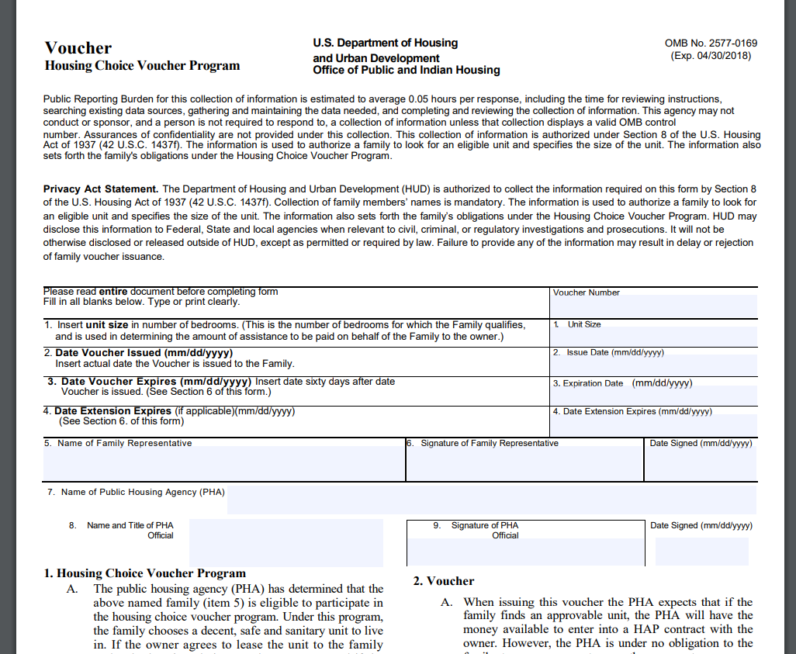
Your voucher is your contract with the PHA
NYC HPD Division of Tenant Resources
11
Notes:
Your voucher is your contract with the PHA
It has information specific to your situation, such as the number of bedrooms you are approved for (unit size).
You'll see the: Date the voucher was issued – this is when the clock starts running on the amount of time you will have to find an apartment. You have 180 days to search.
You'll see the expiration date – the date by which you must submit all paperwork for a unit.
It will have the description of your obligations to the PHA and how to keep your voucher
Point out the expiration date and the PHA’s responsibility
11

Slide 12
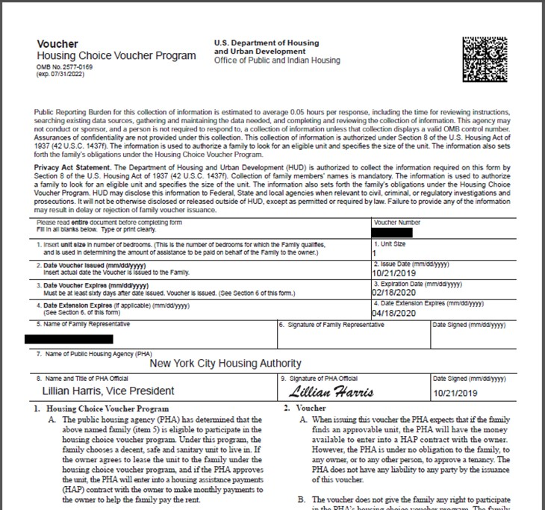
Your voucher is your contract with the PHA
NYC HPD Division of Tenant Resources
12
Notes:
If your voucher is administered by NYCHA, your voucher will look the same, except in the upper right corner, you'll see a little box with a unique barcode. This lets NYCHA know this voucher is specific to your household.
12

Slide 13
Searching for an apartment
with an EHV
NYC HPD Division of Tenant Resources
13
Notes:
By a raise of hand…
Who here has searched for housing in New York City? What was that experience like?
Who here has searched for housing in New York City with a voucher? Or has friends and family who have searched for housing in New York City with a Voucher? What was that like? How are you all feeling about beginning this search?
13

Slide 14
We are here to help
NYC HPD Division of Tenant Resources
14
Notes:
You’re not alone if your experience in the rental market or with a voucher specifically has been hard. With the EHV program, we offer search support and financial assistance to make your experience easier. There will be new terms, paperwork, and it will take some work to find your apartment.
14

Slide 15
Housing Search
1. Figuring out your rental budget (i.e. your “payment standard”)
2. Deciding where and how to search
3. Choosing and applying to an apartment
4. Paperwork and approval
NYC HPD Division of Tenant Resources
15
Notes:
(Read before slide)
We know that searching for housing in New York City can be difficult, and searching with a voucher may seem overwhelming. But we want to make sure that you come away from this workshop feeling like you have a good idea of what you need to know to succeed in finding an apartment and to feel confident about the program and the resources provided to you.
Next, we will go over payment standards, broker’s fees, and the security voucher assistance.
Then, we'll talk about how you might think through deciding where to search for housing, as well as resources for how to search available units.
We'll talk about how you might choose an apartment, and what to do once you've decided you want to move forward.
And finally, if you move forward with a unit, what does it look like in terms of paperwork and HPD/NYCHA approving the unit.
15

Slide 16
Step 1: Figuring out your rental budget
NYC HPD Division of Tenant Resources
16
Notes:
The first step in your housing search process is understanding what rent prices to look for.
SMALL PAUSE
16

Slide 17
Financial Assistance – Broker Fee
Broker Fee:
If you choose to work with a broker or if the owner has hired a broker to show their apartment, brokers may charge 15% of the annualized rent
The City will pay this broker fee if the broker helps you lease up a unit
NYC HPD Division of Tenant Resources
17
Notes:
(Says Before Slide)
Before we get into how much your voucher will cover, we want to make sure you know what assistance is available to you.
If you decide to work with a broker to find available units, your broker fee is covered. A broker can be very useful because they often know about units that haven't been listed yet, and once they know what you're looking for in terms of neighborhood, accessibility, amenities, they can show you all the units in your price range that fit your needs.
Brokers can also manage conversations with the Landlord so you don't have to.
17

Slide 18
Financial Assistance – Security Voucher
Security Voucher/Owner Payment
Most apartments will require you to pay a security deposit, equal to one month of rent
The City will make sure the owner receives this amount
NYC HPD Division of Tenant Resources
18
Notes:
Landlords require a security deposit to move in. This is usually equal to about one month of rent, and the landlord holds on to it until you leave the apartment, in case they need to pay for any damages when you move out. If you are eligible through HRA, you will receive a security voucher form that does not expire, which the landlord can bring back to HRA at the end of your tenancy to receive any funds they need. If you are eligible through HPD or NYCHA, we will pay the owner a one-time payment equal to the security deposit.
18

Slide 19
Financial Assistance – How to Apply
When you receive your voucher, the PHA will tell you if the broker fee & security deposit will come from:
HRA or HPD/NYCHA
If HRA:
You must have or open a Public Assistance Case
Your caseworker or Housing Navigator will help you submit the other paperwork (different from One-Shot Deal)
If HPD/NYCHA:
There will be two extra forms the broker & owner will need to fill out and submit to HPD/NYCHA along with the rental package
NYC HPD Division of Tenant Resources
19
Notes:
To open a PA Case you will need to apply through access HRA under cash assistance. (if you don’t already have one open)
Secondly, you’ll need to complete an interview with the HRA worker assigned to the case.
Then you can submit the paperwork the caseworker by uploading documents through the access HRA portal.
19

Slide 20
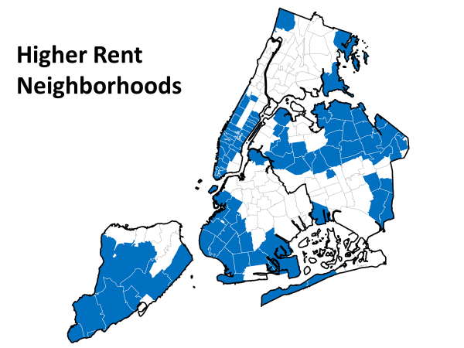
NYC Neighborhoods & Payment Standards
Notes:
It is important to understand with the EHV program how much the PHA will pay for rent across New York City.
You can see in this map, that there are some neighborhoods in blue, and some neighborhoods in white. The neighborhoods in white all have the same payment standard. But keep in mind you are open to moving to any of the areas on the map however we want you to know that the blue areas payments standard is higher.
20

Slide 21
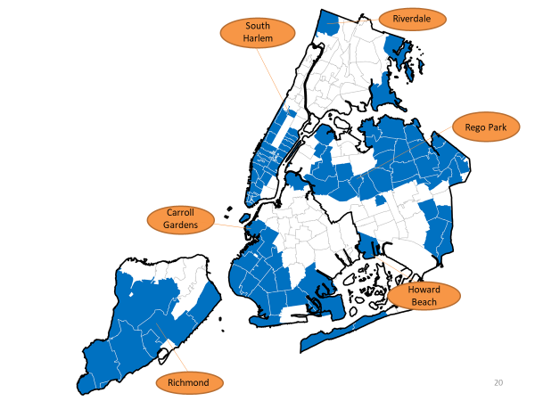
Higher Rent Neighborhoods
Notes:
You can see that the areas shaded in blue are neighborhoods that are typically more expensive. Maybe they are neighborhoods that you thought the voucher couldn’t afford.
But with EHV, you really do have a choice in where you live. You can see here these neighborhoods include areas like… [list areas].
Riverdale
South Harlem
Rego Park
Howard Beach
Richmond
Carroll Gardens
21

Slide 22
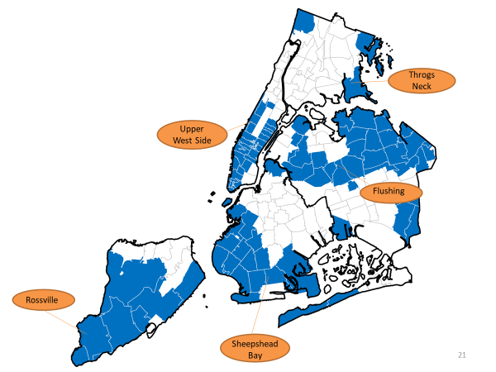
Higher Rent Neighborhoods
Notes:
Throgs Neck
The Upper West Side
Flushing
Sheepshead Bay
Rossville
If you choose to live in one of these neighborhoods, the voucher will pay more, with no increase in cost to you. With an EHV, you can choose to search for housing in any neighborhood.
22

Slide 23
Your voucher pays assistance by neighborhood
For example, the maximum assistance paid can look like the below:
In Crown Heights, Brooklyn, 11216, a 1-bedroom voucher can pay up to $2,218
In Park Slope, Brooklyn, 11215, a 1-bedroom voucher can pay up to $3,326
And:
In Elmhurst, Queens, 11373, a 2-bedroom voucher can pay up to $2,732
In Riverdale, Bronx, 10471, a 2-bedroom voucher can pay up to $2,830
NYC HPD Division of Tenant Resources
23
Notes:
The payment standard first depends on the zip code, and then it depends on the number of bedrooms you have been approved for.
23

Slide 24
Explore what your voucher can pay for
To see payment standard information for every zip code, visit:
www.nyc.gov/hpd-payment-standards
These payment standards apply to all EHV participants, whether your voucher is from HPD or NYCHA.
NYC HPD Division of Tenant Resources
24
Notes:
The payment standard first depends on the zip code, and then it depends on the number of bedrooms you have been approved for.
Click on the website to show how to use payment standard search tool.
24

Slide 25
Utility allowances
One section of the Landlord/Rental Package is for utilities: who pays for gas, water, electric, heat, etc.?
For example, in one building the landlord may pay for heat, water, gas, electric, and the tenant is responsible for no utilities.
In another building, the landlord may pay for heat and water, but the tenant must pay for gas and electric.
In a different building, the landlord pays for no utilities, and the tenant must pay for heat, water, gas, and electric.
NYC HPD Division of Tenant Resources
25
Notes:
(Say Before Slide)
HPD/NYCHA will worry about the calculations regarding utilities, but it will be important for you to discuss with the landlord what utilities you will be paying. You may have to set up an account for each of the utilities you have to pay for when you move in.
PAUSE ARE THERE ANY QUESTIONS?
25

Slide 26
Step 2: How do you find an apartment?
NYC HPD Division of Tenant Resources
26
Notes:
Just so you know......You’ve got options!
1. You can work with a Housing Navigator or Housing Specialist to guide you through your search
2. You can search for apartments on your own
3. You can work with a broker
4. You can do all of the above options
26

Slide 27
Working with a Housing Navigator/Housing Specialist
Here are some of the ways they can work with you:
Understanding your specific apartment and neighborhood needs
Searching for available apartments
Understanding any potential barriers to finding an apartment (credit, eviction history, etc.)
Schedule viewings for apartments
Work with the owner/broker to fill out the Landlord/Rental Package
NYC HPD Division of Tenant Resources
27
Notes:
(Before Slide)
You may have been connected already with someone from your referring agency (for example ACS, DYCD, Safe Horizon, CAMBA, etc.) or a housing navigator. They may have already reached out to you, or in the coming weeks, you'll get a call.
27

Slide 28
Searching on your own
The internet is the most common place to search for a unit, and it often provides the most up-to-date information on apartment availability.
There are multiple apartment search sites. We cannot make recommendations or endorsements.
Commonly used sites include:
www.affordablehousing.com housingconnect.nyc.gov
www.streeteasy.com www.apartments.com
"Fee" vs "No Fee" listings
NYC HPD Division of Tenant Resources
28
Notes:
(Read Before Slide)
We also encourage you to search for apartments in your own time, even if you’re also working with a housing navigator or a broker.
Using apartment search sites will allow you to enter information to filter your search, including rent price, number of bedrooms, neighborhood, etc.
Some sites will list “fee” or “no fee” on the units. “Fee” means the apartment is connected with a broker that will collect a broker fee from you if you lease that unit. “No fee” means that there is no broker’s fee associated with the unit.
28

Slide 29
Other Resources
HPD’s housing search page offers more information about searching for units:
https://www1.nyc.gov/site/hpd/services-and-information/section-8-housing-search-resources.
page
The City’s Neighborhood Exploration Tool allows you to look at more neighborhood information:
nyc.gov/neighborhoodexplorer
NYC HPD Division of Tenant Resources
29
Notes:
29

Slide 30
Things To look Out For
“Background/credit check fee:”
“Stable employment required”
“Income 40x the rent"
“Decent credit (640+)”
“No evictions or court judgments allowed”
"No dogs"
NYC HPD Division of Tenant Resources
30
Notes:
Before Slide:
When you’re looking at apartment listings online, you may come across some of this language:
Background/credit check fee: Listed sometimes as a tenant screening fee. The owner is only allowed to charge $20 per adult in the household.
Stable employment required: This is "source of income" discrimination! A property owner must accept any lawful income whether it comes from work, child support, rental subsidy, trust fund. The property owner cannot require the tenant to be working or to maintain a certain type of employment. If you have section 8 assistance or EHV, you may apply even if you are not working.
Income 40x the rent: You cannot be denied an application or an apartment based solely on a minimum income requirement, your voucher will cover rent up to the payment standard.
Decent credit: Property owners may not require a minimum credit score. Credit must be considered on a case-by-case basis.
No evictions or judgments allowed: Property owners can only consider housing court history on a case by-case-basis. You cannot be denied an apartment or application based solely on your rental history.
No dogs/pets: apartments must allow service animals
BIG PAUSE
30

Slide 31
Working with a tenant-facing broker
If you would like more specialized help looking for apartments, you can also work with a broker
They know neighborhoods very well and often know about available apartments before they are listed online
They can take you to multiple viewings in a day
Brokers can receive payment through the EHV program if they help you lease a unit (after all paperwork submitted)
NYC HPD Division of Tenant Resources
31
Notes:
Of course, you can also work with a broker to search for housing.
Please be aware the City will only pay for licensed brokers. Brokers often hire Real Estate Agents to expand their reach.
Know a Broker’s rights. A broker has a right to collect a Broker’s fee if you find a different unit on your own in a building that he/she showed you a unit in. Don’t be afraid to ask the Broker about apartments that are not listed online yet.
You should NOT be charged a Broker’s fee higher than 15% of the annual rent.
Don’t let a broker pressure you in your housing search. Don’t be afraid to walk away from someone you’re not comfortable with.
There are scammers Do Not give any money to an Agent or Broker. Remember they will get paid through the EHV program if you lease an apartment they have shown you.
PAUSE: ARE THERE ANY QUESTIONS?
31

Slide 32
Step 3: Choosing and applying for a unit
NYC HPD Division of Tenant Resources
32
Notes:
32

Slide 33
EHV leasing process
Receive Voucher
(180 days total to search)
Search for housing with support from Housing Navigators, Housing Specialists, brokers
Apply for units you like
If your application is accepted, submit a Landlord Package to HPD/NYCHA for review
HPD/NYCHA review the paperwork, then make sure the unit is safe
HPD/NYCHA issue a conditional move-in approval notice
You sign an official lease
Owner signs and returns lease & HAP contract to HPD/NYCHA
HPD/NYCHA issue Rent Breakdown letter
NYC HPD Division of Tenant Resources
33
Notes:
(Say Before Slide)
So you’re searching for housing and you find a unit. What does the process look like?
Reminder that details vary slightly between HPD or NYCHA.
Here’s an overview of what to expect. We’ll walk through these steps in some more detail.
33

Slide 34
After finding a unit
Complete the apartment application*
2. Background/credit check*
*$20 maximum per every adult in NYC
3. If you are approved for the apartment, the owner needs to complete the Landlord/Rental Package
NYC HPD Division of Tenant Resources
34
Notes:
(Before Slide)
Once you have found a unit you want to apply for, you will go through these steps first.
34

Slide 35
Apartment application
First you will need to apply for the apartment through the broker or the owner
Paper application or online application
You might need to provide:
Copy of EHV Voucher
Proof of Income (pay stubs, tax return, employment letter, PA letter)
Bank statements
Government Issued ID
References or Reference Letter
Application Fee (up to $20 per adult member, per unit)
NYC HPD Division of Tenant Resources
35
Notes:
35

Slide 36
Step 4: PHA paperwork and approval
NYC HPD Division of Tenant Resources
36
Notes:
SMALL PAUSE
36

Slide 37
Landlord/Rental Package
If you are approved for the unit, the owner needs to fill out paperwork:
NYCHA: online rental package
HPD: emailed/printed landlord package
It is important that the package is filled out completely and all signatures are complete!
Make sure you sign the tenant portion of the package (HPD) or approve the package in the Self Service portal (NYCHA)
NYC HPD Division of Tenant Resources
37
Notes:
(Say Before Slide)
If you are approved by the landlord, then they will need to fill out a rental/landlord package to submit to NYCHA or HPD.
When you were issued your voucher, you also received a Landlord Package/Rental Package
HPD sends the Landlord Package by email
NYCHA provides a pin number to be used for the landlord section of the NYCHA Portal.
This package needs to be filled out by either the owner or the owner's representative, and then sent back to HPD/NYCHA
It is very important the package is filled out completely, and all signatures are complete
If the package is incomplete, we will reach out to the owner.
The apartment will also need to be inspected to make sure it meets “housing quality standards.”
37

Slide 38
Inspection
It is important that your apartment is safe and there are no dangerous conditions
Your apartment will be inspected before you move in
If everything is in good condition and the apartment is safe, HPD/NYCHA will move forward in processing your case
NYC HPD Division of Tenant Resources
38
Notes:
For example, we want to make sure that there is no mold, that the appliances like the oven work, that the electricity and all the outlets work. During your walk through of the apartment it is encourage that you also look for these things.
38

Slide 39
Step 5: Moving In and what to expect
NYC HPD Division of Tenant Resources
39
Notes:
39

Slide 40
Lease signing and move in steps
1. HPD/NYCHA will send you a conditional move-in approval notice with the date you can move in and a HAP contract to the owner.
2. You will sign a lease with the owner, and the owner will send that lease and the HAP contract to HPD/NYCHA
3. You will coordinate with the broker, owner, or housing navigator to receive your keys
4. You will receive a rent breakdown letter listing your rent and the amount you must pay to the owner each month
NYC HPD Division of Tenant Resources
40
Notes:
The HAP is the contract between your landlord and HPD/NYCHA, this allows the landlord to get paid each month by HPD/NYCHA.
You will be notified when the HAP contract is approved by the HPD/NYCHA this will allow you to move into the unit.
40

Slide 41
After move in
Keep your lease and Notice of Approval letter in a safe place
Pay your portions on time and keep all payment receipts
Keep important contact information in your records and report any changes to your income or household composition.
You should receive information about completing an annual certification about 7 to 8 months after you move in. Complete and return it on time.
Within a year or two after you moved in, HPD or NYCHA will schedule an inspection, be sure to grant access to your unit.
NYC HPD Division of Tenant Resources
41
Notes:
41

Slide 42
Finding an apartment – know your rights
It is illegal for property owners, brokers, or managing agents to refuse to rent to you because you have a voucher. This is called Source of Income Discrimination.
If you believe you have been the victim of housing discrimination, you can discuss it with your housing specialist or navigator.
Everyone, including DHS clients can call 311 or report it online to the New York City Commission on Human Rights (CCHR)
Report Discrimination - CCHR (nyc.gov)
NYC HPD Division of Tenant Resources
42
Notes:
Sometimes you hear “we don’t accept vouchers” or “no programs.” this is illegal.
It is also illegal to discriminate against you based on:
Race
Color
Religion or creed
Age
Sexual orientation
National or ethnic origin
Gender or gender identity
Citizenship status
Handicap or disability
Family, Marital, or Partnership status
Reminder: Click on link and show them the CCHR application that pops up!
42

Slide 43
Finding an apartment – know your rights
For Residents Living in Shelter
Department of Social Services (DSS)
Source of Income Discrimination Unit (SOI)
Email: soi@dss.nyc.gov
Call: 929-221-6575
The law also protects you from an owner who tries to punish you for filing a complaint.
NYC HPD Division of Tenant Resources
43
Notes:
(Before Slide)
Voucher holders living in a shelter can reach out directly to DSS Source of Income Discrimination Unit by email or phone. You can report what happen to the DHS housing staff and they can assist with the email or call to SOI. If you file a report and the claim is confirmed, the owner may be required to rent the unit to you.
It is against the law for an owner to retaliate or "coerce, intimidate, threaten, or interfere" with you to prevent you from filing a complaint or to punish you for filing a complaint.
43

Slide 44
Portability Transfer
“Portability" in the EHV program refers to the process through which a family can transfer or "port" their rental subsidy to a location outside the jurisdiction of the public housing agency (PHA) that first issued them the voucher.
HPD and NYCHA both offer EHV participants the opportunity to travel outside of the Five Boroughs or move anywhere in the United States.
HPD and NYCHA will require the family to submit a portability transfer request form.
There may be some common differences to be aware of:
Voucher size could possibly change with the new receiving PHA
Also, the payment standard may increase or decrease depending on the receiving PHA’s criteria

Slide 45
Portability Transfer: How Do I Port Under EHV?
Contact HPD with your request to port.
Complete the Port Out Request Form, found here: https://www1.nyc.gov/site/hpd/services-and-information/section-8-forms.page
Submit your form by:
Email: Portability@hpd.nyc.gov
Online: Document Upload Portal here: https://www1.nyc.gov/site/hpd/services-and-information/section-8-forms.page
Mail to: Client Services, 100 Gold Street, Room 1-O, New York, NY 10038
Fax to: 212-863-5299
If eligible, you will:
Submit your portability paperwork, which HPD will mail to the new PHA where you are porting to—the “Receiving PHA”
Be briefed by HPD on the Port Process
Get a Voucher from HPD to start your housing search
To learn more about the EHV Portability Process, please read the Portability FAQs here: https://www.nyc.gov/site/hpd/services-and-information/moving.page

Slide 46
Family Self-Sufficiency (FSS) Program
HPD and NYCHA both offer a program to help you achieve your goals related to education and employment
You can work with a staff member to sign up for classes, take trainings and increase your employment opportunities
As your income increases, HPD/NYCHA will create a savings account for you!
To learn more:
NYCHA http://opportunitynycha.org/about-financial-empowerment/fss/
HPD nyc.gov/hpd/fss
NYC HPD Division of Tenant Resources
46
Notes:
46

Slide 47
Things you should know
You can work with a housing navigator/housing specialist to guide you in your housing search
The amount your voucher will cover depends on the zip code of the unit (www.nyc.gov/hpd-payment-standards)
The City will pay for a broker
The City will take care of the security deposit
More resources (https://www1.nyc.gov/site/hpd/services-and-information/section-8-housing-search-resources.page)
NYC HPD Division of Tenant Resources
47
Notes:
(Before Slide)
So what should you remember from this workshop?
47

Slide 48
Contact
NYCHA Hotline 718-707-7771
HPD Hotline 917-286-4300
Reach out to your housing navigator or housing specialist for specific questions on your case.
NYC HPD Division of Tenant Resources
48
Notes:
48

