Slide 1


Slide 2
Beacon Community Center
Pre-Proposal Conference
April 3, 2019

Slide 3
Agenda
Welcome and Timeline
Pre-Qualifying and Proposal Submission
Program Expectations
Post Award Requirements
Question and Answer Session

Slide 4
Timeline
Proposal Due Date: April 24, 2019 at 2:00 pm
Award Announcement: Spring 2019
Contract Term: July 1, 2019 – June 30, 2023
Questions: RFPquestions@dycd.nyc.gov
(Questions must be received by April 12, 2019)

Slide 5
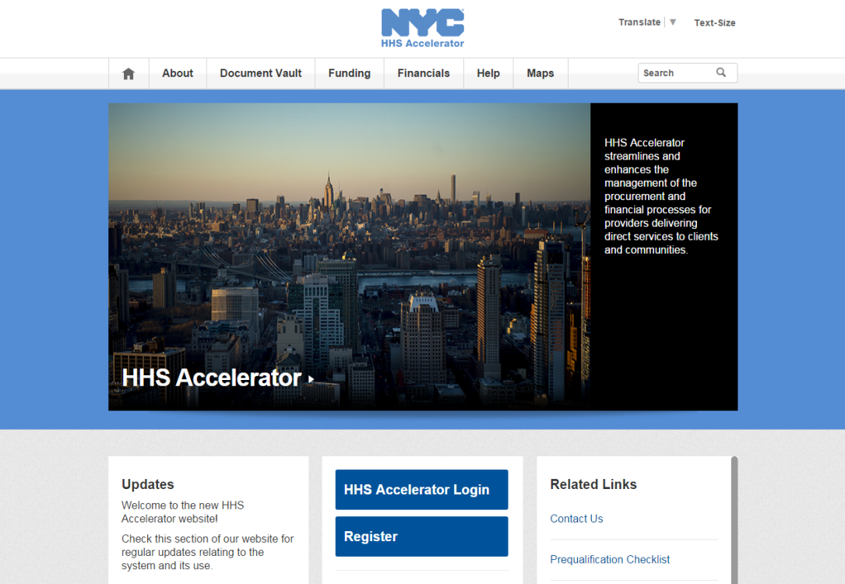
PROPOSING IN HHS ACCELERATOR
The HHS Accelerator System was launched to simplify and improve the competitive contract process for Health and Human Service providers.
Agencies publish all Request for Proposals (RFP) Documents in the HHS Accelerator System.
Prequalified providers approved for relevant Services are “Eligible to Propose” and can submit proposal(s) after RFPs are released.
Providers must submit proposals through the HHS Accelerator System by the proposal due date and time (2 pm).
Need Help?
Contact: help@mocs.nyc.gov

Slide 6


Beacon Community Center
Beacons represent a unique convergence of youth and community development, aiming, in particular, to keep youth out of harm’s way while simultaneously strengthening local communities through an integrated range of services, provided in an educational environment, and tailored to community needs.
The De Blasio Administration committed $6.2 million in FY’18 and out to establish new beacon programs in underserved communities. Sites selected were based on two primary analysis: (1) Youth Population by Borough and (2) in partnership with NYC DOE identifying schools with limited to no services.
This RFP is informed by DYCD’s mission and vision to alleviate the effects of poverty by drawing on the strengths of individuals and communities, promoting synergy among programs and providers, and creating a culture that supports community-building efforts.
Notes:
Administration has committed to a significant increase in funding for the Beacon initiative, with goals that are closely aligned with Mayoral priorities of equity and opportunity in the areas of education, health and well-being, empowered residents and neighborhoods, and personal and community safety

Slide 7
Program Goals
Promote positive development by providing safe environments, supportive relationships, high expectations, family engagement and intergenerational activities.
Trusted, neighborhood hub that helps community members access services, strengthens community bonds, and fosters a sense of belonging.
Provide opportunities for all participants to develop skills, increase personal and family well being.
Strengthen community life by expanding partnerships, tapping into City’s resources, encouraging residents to participate in neighborhood activities and connecting community resources to the Beacon.
Support student engagement in school, including among students with chronic absenteeism.
Ensure participants and community members are viewed as potential contributors to the Beacon and the community, are enlisted to help identify local needs, and engaged in the ongoing development of Beacon programs.

Slide 8
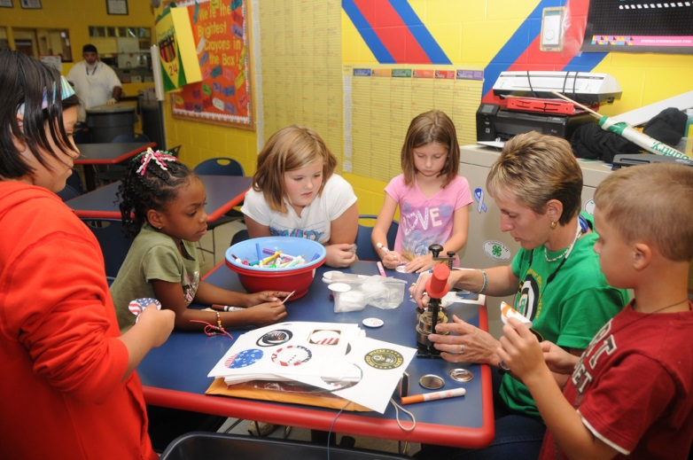
Program Services
Three types of program activities:
Drop-In: Recreational, self-directed and one-time services/consultations. Activities are not structured in scope but can be used as a vehicle to recruit and engage youth/adults in regularly scheduled activities.
Planned: Designed to offer participants a chance to pursue passions, explore interests, acquire knowledge and develop skills. Activities must have clear purpose and objectives.
Community Events: Designed to reflect the interests and needs of the community. Beacons must provide a minimum of three events per year, including one on health.
Core Activity Areas:
Education
Community Building/Leadership
Health: Healthy Living/Healthy Relationships/Physical Fitness
Employment and Financial Security
Recreation and Enrichment
Notes:
Types of Activities
Drop-In: open gym, teen lounge, one-off informational sessions.
Planned activities: clearly articulated learning goals and skill gains…typically follow curriculum or set of lesson plans and require regular attendance.
Community events: include but not limited to community service/beautification day, open house to market and recruit.
Core Area:
Education: academic support, literacy classes, vocational training, HS/College application, resume writing, etc.
Community Building/Leadership: civic engagement, service learning
Health: sports, yoga, nutrition, mentoring, etc.
Employment: career opportunities, internships, financial literacy, etc.
Recreation: arts projects, book clubs, theatre groups, dance, etc.

Slide 9
Program Services: Outcomes
Adult Services
Beacons would include programming for adults that reflects their specific needs and interests, and contributes to their well-being.
Outcomes
Participant satisfaction with Beacon services. Indicator: 80% of respondents to participant satisfaction surveys.
Beacon makes all necessary external and, if applicable, internal referrals to address needs. Indicator: Responses to the participant satisfaction survey confirm necessary referrals were made.
Social and Emotional Learning. DYCD anticipates introducing an SEL outcome based survey tool that will assess motivation, self-awareness and decision making.
Notes:
Adult activities: activities include but its not limited to yoga, aerobics, computer literacy, ESOL, GED, etc.

Slide 10

Staffing Structure
Key staff positions: Beacon Director, Outreach coordinator, and other staff who provide regular and substantial direct services to youth and adults.
Full-Time Beacon Director with a Bachelor’s Degree or Higher Education with a minimum of five years of relevant experience. Responsibilities include but not limited to:
Overall responsibility for administration of program
Coordinate with the principal of host school and other community stakeholders
Represent the program at school leadership meetings
Work with staff to ensure quality activities
Outreach Coordinator
Must be familiar with neighborhoods and are trusted by local youth. This person would engage youth who would otherwise not be enticed to enroll in the program, but stand to benefit the most from its services. As well as work with chronically absent youth, identified as part of the Beacon goals.
*Resource Coordinator
Responsible for coordinating and making referrals, serve as liaison with other units of the contractor’s organization, as well as external partners, i.e. co-locators/sub-contractors.
* Could be assigned to Director

Slide 11
Staffing Structure
Please note that the staffing plan must comply with staff-to-participant ratios for children 5 to 13 years required under the New York State SACC Regulations. In addition,
Staff at all levels must …
Be familiar with the neighborhood
Have the necessary language skills to effectively communicate with and serve non-English-speaking participants.
Culturally responsive: Sensitive to the diverse languages, cultures, traditions, lifestyles, family structures, and sexual orientations and gender identities of participants and will integrate that knowledge into their service delivery.
Linguistic and communication skills to be able to reach out and interact with newcomers to the City in positive ways and respond effectively to their needs.
The necessary knowledge and literacy and numeracy skills to provide appropriate assistance.
Have experience delivering project-based activities that successfully engage teens and young adults.
Have the experience and managerial skills needed to provide, lead, and coordinate the activities for adults.

Slide 12
Program Expectations: Approach
Strength-based Frameworks:
Positive Youth Development (PYD)
Social and Emotional Learning (SEL)
Youth Leadership
Safe, Welcoming and Inclusive Environment
The contractor would have protocols for staff behavior and effective training and supervision to ensure the environment is friendly and supportive and everyone is treated with dignity and respect, starting from the very first encounter with program staff.
Family Engagement
Family engagement comprises three critical elements: Communication (i.e., strong and positive family interactions); Participation (i.e., families access the services they need); and Mutually-beneficial partnerships (i.e., family members assume leadership roles and take shared responsibility for outcomes).
Notes:
DYCD expects all the programs it supports to recognize and value the strengths and capacities of individuals and communities.
PYD is an assets-based approach that fosters healthy development and resilience by offering a safe environment, a sense of belonging, and authentic opportunities for participants to be heard and effect change in their lives.
SEL involves intentional development of key skills including self-awareness, self-management, social awareness, relationships and responsible decision-making. Youth Leadership builds on SEL competencies by adding a focus on action (using skills learned to effect change), and reflection (reinforcing lessons learned, building confidence, responding to new challenges).

Slide 13
Annual Target Population/Service Levels
Age Category | Activity Type | Number | Enrollment Criterion
Youth, under 22 years | Drop-In and planned activities | *600 | 3 Visits
Adults 22 years and older | Drop-In and planned activities | 100 | 1 Visit
Adults and Youth, any age | Community Events | 500 | 1 Event
Total |  | 1,200
* Of the 600 youth under 22 years, DYCD expects Beacons to enroll at least 100
elementary, 100 middle school students and 100 high school-age youth.
* The 600 youth are inclusive of summer camp services.
Notes:
The Beacon would provide activities and services for school-age youth, families, and adults ages 22 years and older, including seniors.
For the purpose of required minimum service levels for drop-in and planned activities, youth must visit the Beacon program at least three times and adults must visit at least once. For community events, participants of all ages count if they attend at least one event.

Slide 14

Target Population/Service Levels: School Year Dosage Requirements
At least 100 must reflect the grade levels of the host school.
The other 100 can represent any other grade level and/or the community.
200 meet dosage requirement

Slide 15
Target Population/Service Levels: School Year Dosage Requirements
School Year – Intensive Participation Levels - 200
Grade/Age | Measure | Target | 200 Total
Elementary (K-5) | Average Daily Attendance | 80% | #
Middle (6-8) | Hours of Beacon activity | 150 hours per participant per school year | #
High School Age (9 -12) and out of school youth through age 21 | Hours of Beacon activity | 100 hours per participant per school year | #
School Year (36 Weeks)
Minimum Hours per Week | Operating Schedule | Total School Year Operating Hours
42 hours over 6 days (Mon-Fri and Sat or Sun) | Weekdays Start: End of the school day End: No later than 10pm Weekends To be negotiated with host school | 1,512
Notes:
At least 15 school closing days during the school year program is expected to operate for 10 hours a day, from 8am – 6pm, for a total of 150 hours. Provider selects days according to community needs.
Another item that needs to be flagged during contract negotiations.

Slide 16
Target Population/Service Levels: Summer Operating Hours
Proposers must choose one of the three options set out below. Under all three options, the Beacon must offer a summer camp program for at least some elementary grade students.
Summer (7 weeks) Proposers must select an option
 | Minimum Hours Per Week | Operating Schedule | Total Summer Hours | Minimum Enrollment Requirements
Option I | Mon-Fri 70 hrs. Weekend 7 hrs. Total: 77 hrs. | 8am – 10pm Sat or Sun 3pm-10pm | 539 | 175 participants
Option II | 64 hrs. per week | Flexible | 448 | 225 participants, including at least 50 youth under 22
Option III | Mon-Fri 50 hrs. | 8am – 6pm | 350 | 275 participants, including at least 100 youth under age 22
Note the following:
Option I: Enrollment contributes to annual minimum enrollment for the Beacon 1,200
Option II: This would raise the annual minimum enrollment for the Beacon to 1,250
Option III: This would raise the annual minimum enrollment for the Beacon to 1,300
Notes:
All programs expected to operate 8am – 6pm
Option I: Enrollment contributes to annual minimum enrollment for the Beacon 1,200
Option II: This would raise the annual minimum enrollment for the Beacon to 1,250….Flexible evening hours.
Option III: This would raise the annual minimum enrollment for the Beacon to 1,300

Slide 17

Community Partnerships
It is anticipated that proposer has strong community connections and sound knowledge of services in the neighborhood.
Contractor would have a minimum of three community partnerships.
Community Partnership Agreements must be submitted along with the proposal.
Each Beacon must have an Advisory Council that meets at least four times a year.
To ensure that middle and high school-age youth have meaningful leadership opportunities, the Beacon would either ensure youth are adequately represented on the Advisory Council or establish a separate Youth Advisory Council.
Reminder: Agreements must include description of services, type of services that will be provided and description of process for making referrals if the partnership involves referrals.
Notes:
If the contractor is a multi-service organization, community connections may include other unites, divisions or programs operated by the contractor’s own organization.
Partnership may include ongoing referrals, joint projects, and co-location of services and sub-contracts.
Advisory Council primary role is to contribute to the assessment of community needs.

Slide 18

Office of Community Schools at the Department of Education
The Office of Community Schools supports schools to work with Community Based Organizations (CBOs) to become places where children have opportunities to learn, gain skills, create joy and have experiences that ignite curiosity and allow children to discover their passions and talents.

Slide 19


Community Partnership: School/CBO
A positive and productive relationship between the Beacon and its host schools is fundamental to program success.
School Partnership Agreement (SPA) is a minimum requirement for the RFP.
Principals will need to sign off on a School Partnership Agreement (SPA) and proposals will not be considered without the principal’s signature. Principal’s have the option of signing multiple SPAs – each of the proposals will be considered. The proposal with the highest score will be awarded a Beacon contract.
The Office of Community Schools has worked with DYCD to prioritize and strengthen relationships in this new RFP – for instance, the host school Principal and CBO leadership will be expected to work collaboratively in defining and establishing Beacon Director expectations including but not limited to being part of the hiring process. Additional items include but are not limited to:
Principal identifying a liaison from his/her staff to facilitate ongoing communication.
Beacon Director being part of school governance structure.
Established regularly scheduled meetings with Principal or designee.
Identifying allocated space including but not limited to classrooms and resources.
Note: The partnership between the proposed provider and the school/community must be clearly described and demonstrated in the proposal.
Notes:
The school partnership will ensure alignment between the Beacon program and other services at the host school and in the surrounding neighborhood.

Slide 20
IMPORTANT INFORMATION NYC Liability Insurance Requirement
Commercial General Liability
$1 million per occurrence and $2 million aggregate;
Motor Vehicle Liability (if applicable)
$1 million per accident combined single limit;
Workers’ compensation
Employer’s liability Insurance
Disability benefits Insurance
An original certificate of insurance naming the City of New York, including its officials and employees, as an additional insured.
DYCD will not be able to proceed with processing an awarded contract until it has obtained proof of the necessary insurance coverage.

Slide 21
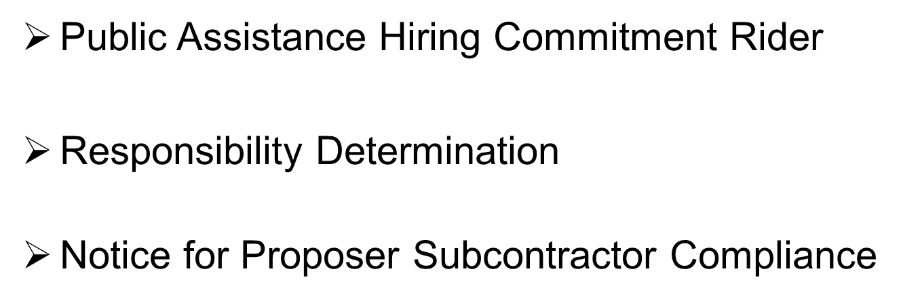
POST AWARD REQUIREMENTS

Slide 22
Questions?
RFPquestions@dycd.nyc.gov

