Slide 1
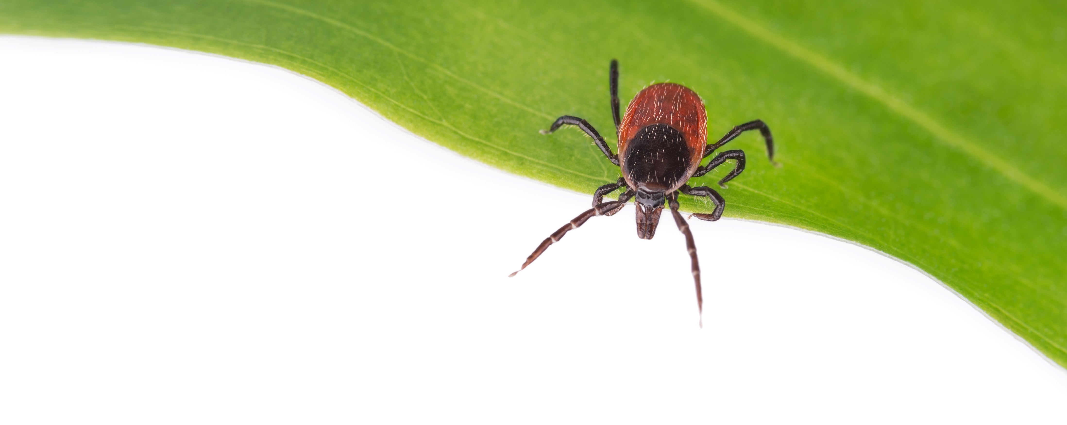
Ticks and Tick Bite Prevention
New York City Department of Health and Mental Hygiene
Grades 3 to 5
Notes:
Prepared by the New York City Department of Health and Mental Hygiene, Bureau of Communicable Diseases, Zoonotic and Vector-borne Disease Unit, 2024.
Slides have bullet points for the students to follow and presenter notes provide a script with additional explanation.
Expected time is 45 minutes, including activities.

Slide 2
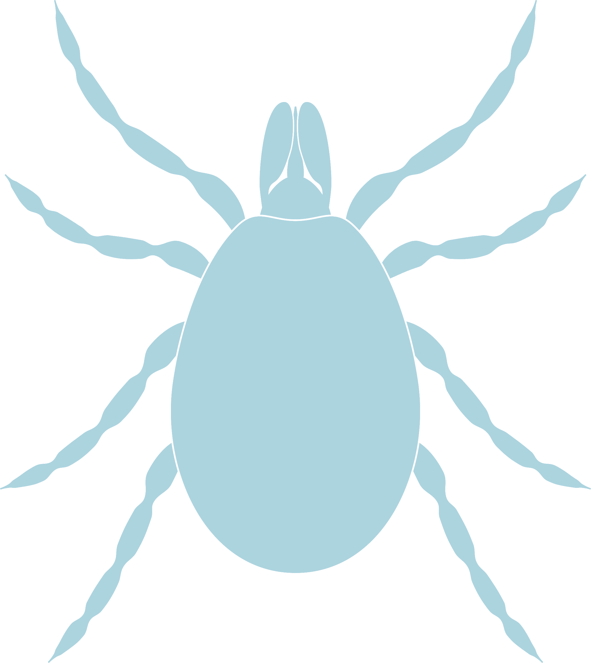
Today we will learn:
What are ticks?
What do ticks look like?
Where do ticks live?
What is Lyme disease?
How do I protect myself?
What if I find a tick on me?
Notes:
Today, we’re going to learn about ticks.
What are ticks?
What do ticks look like?
Where do ticks live?
What is Lyme disease?
How do I protect myself?
What if I find a tick on me?
Ask students if any of them have heard of ticks or Lyme disease. Allow a few students to share.

Slide 3
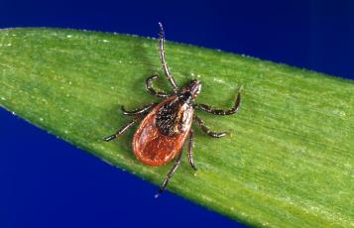
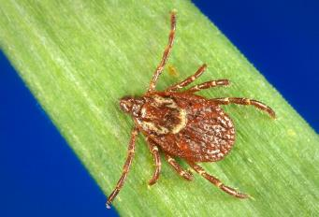
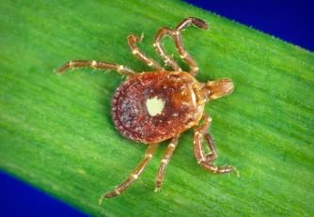
What are ticks?
Ticks are small bugs. They have eight legs as adults.
What other bugs have eight legs?
Today we are going to focus on the blacklegged tick.
Spiders!
Blacklegged tick
Ixodes scapularis
American dog tick
Dermacentor variabilis
Lone star tick
Amblyomma americanum
Images courtesy of the CDC, James Gathany
Notes:
Ticks are small bugs. They have eight legs as adults. We will go over the life stages today.
What other bugs have eight legs? [animated] Spiders!
If you look, ticks look kind of like spiders. That’s because they’re from the same group of animals called Arachnids. They are different from insects.
There are a few different types of ticks in and around New York City that can cause infections. Each looks a little different and each spreads different germs that can make you sick.
[animated] Today we are going to focus on the blacklegged tick, also called the deer tick. The scientific name for this tick is Ixodes scapularis (ick-SO-deez SKAP-pew-lair-iss).

Slide 4
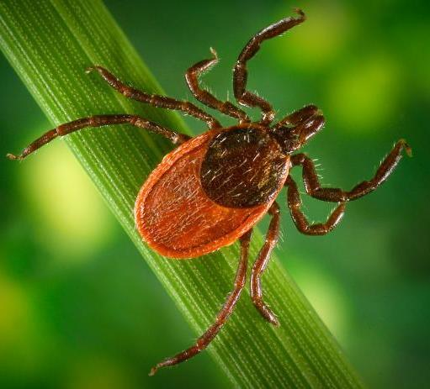
What do ticks look like?
Scutum (shield)
Mouth
Abdomen
Eight legs
No antennae
No wings
Legs
Image courtesy of the CDC, James Gathany
Notes:
What do ticks look like? They have a:
Mouth
Scutum, which is a hard shield on their back
Abdomen
[animated] They also have:
Eight legs
No antennae
No wings
Ticks cannot fly or jump. They can only crawl.

Slide 5
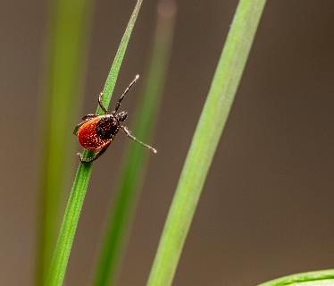
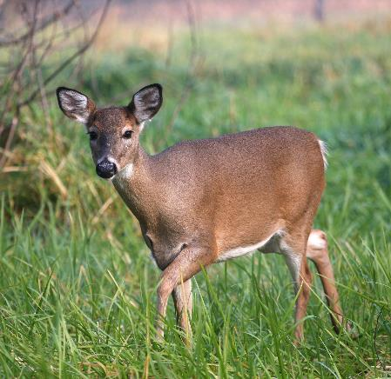
What do ticks eat?
Ticks bite to eat blood from animals like mice and deer.
Sometimes ticks will eat blood from people.
They hold up their front legs in a motion called questing to grab onto fur, skin or clothing.
When an animal or person passes by, they might grab on.
Notes:
What do ticks eat?
Ticks bite to eat blood from animals like mice and deer. Adult ticks like to feed on deer. Therefore, ticks tend to live in areas where there are many deer.
Sometimes ticks eat blood from people.
They hold up their front legs in a motion called questing to grab onto fur, skin or clothing.
When an animal or person passes by, they might grab on.
They will then crawl around until they find a place to feed. When they bite, they stay attached for a few days unless removed.

Slide 6








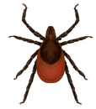



Life Cycle of a Blacklegged Tick
Larvae
Egg
Adult
Nymph
Images courtesy of the CDC
Notes:
Ticks go through a life cycle. The life cycle may look a little different depending on the species of tick.
What are some other examples of a life cycle? Butterflies, tadpoles, people
Ticks must be able to feed on blood from a host animal in order to move on to the next stage of their life cycle. A host is an animal that a tick lives off of.
The life cycle goes like this:
Ticks hatch from eggs
Newly hatched ticks are called larvae and only have 6 legs. Larvae like to eat the blood of small animals, such as mice. They can be thought of as baby ticks.
Larvae then molt (shed their outer skin as they grow) and become nymphs. Nymphs grow one more pair of legs, for a total of 8 legs. They like to feed on medium and large-sized animals, including humans. Nymphs are like the child or teenage stage of a tick.
The nymph then molts one more time and becomes an adult, which also has 8 legs. Adult female blacklegged ticks like to feed on large animals, such as deer. After the female feeds and mates with a male tick, she lays eggs and dies. The life cycle then starts over again.
LS1.B: Growth and Development of Organisms
Reproduction is essential to the continued existence of every kind of organism. Plants and animals have unique and diverse life cycles. (3-LS1-1)
Cross-cutting Concept
Cause and Effect. Ticks that do not find a host to feed on die and do not move to the next stage of the life cycle.
Patterns. Life cycles are a type of pattern that can differ among different species.

Slide 7

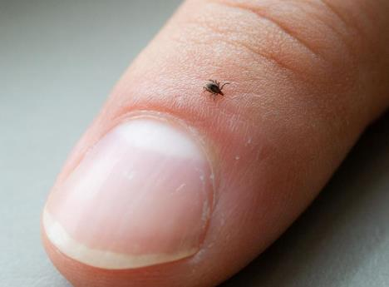
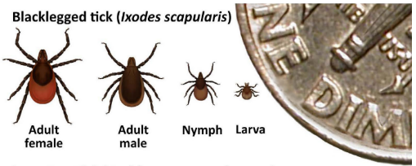
How small are ticks?
Ticks are really tiny.
Nymphs can be the size of a poppy seed.
This makes ticks very hard to see.
Tick Life Series Illustration and Muffin with Ticks, Zoom, courtesy of the CDC
Tick on Thumb, courtesy of the Minnesota Department of Health
Notes:
How small are ticks?
Ticks are really tiny. Nymphs (the stage between larva and adult) are only about the size of a poppy seed, like those found on a poppyseed muffin or bagel.
This makes ticks very hard to see.
Ticks were placed on this poppyseed muffin for size comparison. How many do you see? [animated] There are 5 ticks in the middle of the muffin.

Slide 8


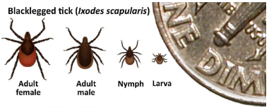
Class Activity
5
mins
Tick Bagels
Instructions
Look closely for ticks on the bagel handout and circle any you find. See if you can tell the difference between sesame seeds, poppy seeds, and ticks.
How many ticks can you count on your bagel?
Tick Life Series Illustration, courtesy of the CDC
Notes:
We will take 5 minutes to see how small ticks look next to the seeds on everything bagels.
Look closely for ticks on the bagel handout and circle any you find. See if you can tell the difference between sesame seeds, poppy seeds, and ticks.
How many ticks can you count on your bagel?
Answer: There are 5 ticks on each bagel. 5 adults on the top bagel and 5 nymphs on the bottom bagel.

Slide 9

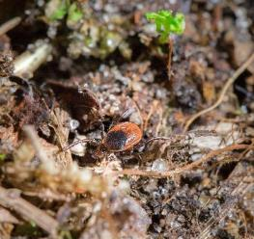
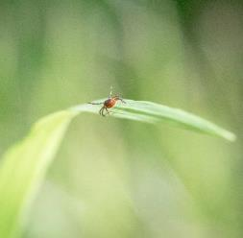
Where do ticks live?
Areas with:
Shade
Woods
Tall grass
Low bushes and shrubs
Dead leaves
Ticks are most active in the spring, summer, and fall.
Images courtesy of the Minnesota Department of Health
Notes:
Where do ticks live?
Ticks live in areas with shade, woods, tall grass, low bushes and under dead leaves.
They like the shade. Ticks do not like being in the sun – they die if they dry out.
Ticks are most active in the spring, summer and fall. Ticks come out when it’s not super cold.
Ticks are often found in places around NYC, such as upstate NY, Long Island, New Jersey, Pennsylvania and Connecticut.
In NYC, blacklegged ticks are found throughout Staten Island and parts of the Bronx. They can be found in yards if you live near woods, parks or other places where ticks might live.
LS4.C: Adaptation
For any particular environment, some kinds of organisms survive well, some survive less well, and some cannot survive at all. (3-LS4-3)

Slide 10

Where are ticks most likely to be found? Select all that apply:
Tree canopy
Shrubs
Tall grass
Leaf litter
Notes:
Where are ticks most likely to be found? Select all that apply:
Tree canopy
Shrubs
Tall grass
Leaf litter

Slide 11
Where are ticks most likely to be found? Select all that apply:
Shrubs
Tall grass
Leaf litter
Notes:
Ticks are most likely to be found in shrubs, tall grass, and leaf litter.
They like to stay near the ground where there is more moisture and more of what they like to feed on, which are animal hosts.

Slide 12
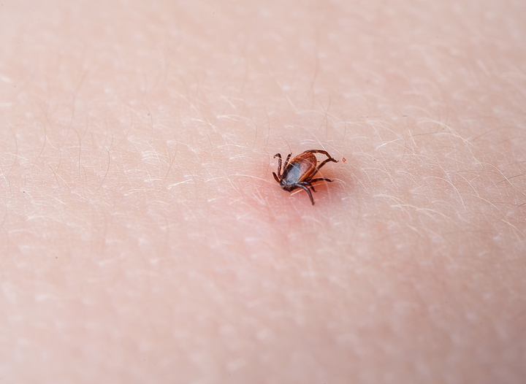
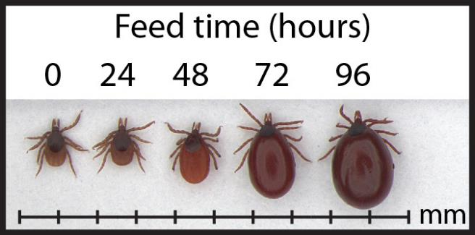
How can a tick make you sick?
Not all ticks can make you sick.
If a tick is infected and bites you, it can spread germs to you that make you sick.
The longer they are attached, the more likely they are to spread the germs.
When a tick is full, it will fall off.
You will usually not feel a tick bite.
Stages of Tick Engorgement, image courtesy of the CDC
Notes:
How can a tick make you sick?
Not all ticks can make you sick.
If a tick is infected and bites you, it can spread germs that make you sick. Infected means it is carrying germs that can cause illness.
Ticks can spread many different diseases, such as Lyme disease, anaplasmosis, babesiosis, tick-borne relapsing fever, ehrlichiosis, and Powassan virus.
(Educators can learn more about these diseases by visiting https://www.cdc.gov/ticks/tickbornediseases/overview.html)
After a tick bites you and begins to feed, it becomes full of blood and may look like a small grape (see Feed Time image).
The longer they are attached, the more likely they are to pass on the germs that can make people sick.
You won’t always get sick from a tick bite
When a tick is full, it will fall off.
You will usually not feel a tick bite.
Tick bites can go unnoticed, which is why we’ll learn later how you can prevent tick bites and check for ticks.
[3-DP 1.1] How germs enter the body and can cause illness.
[4-DP 5.1] Describe the final outcome of a personal health-and wellness-related decision.

Slide 13
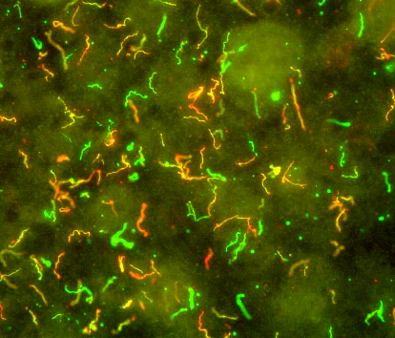
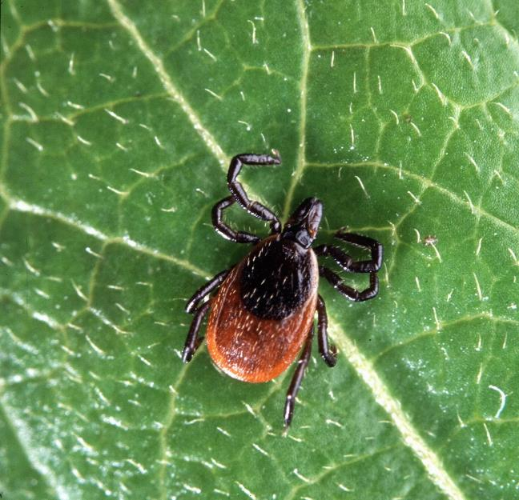
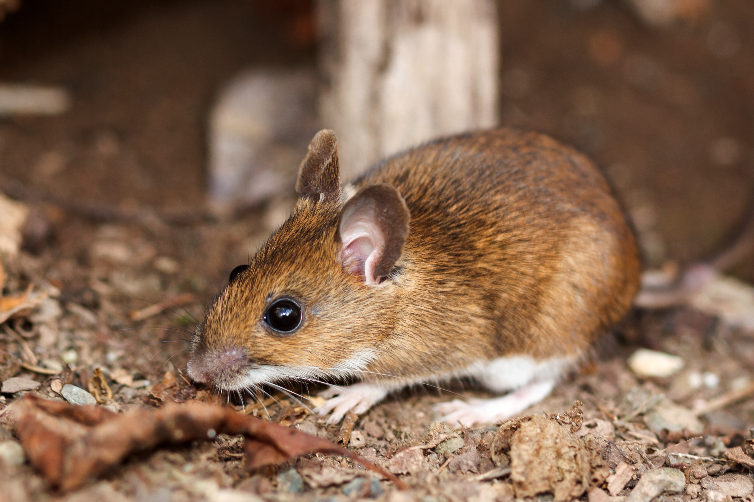
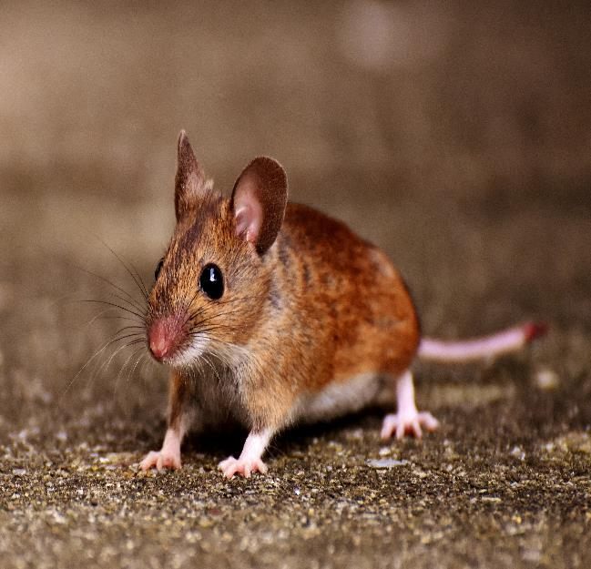
What is Lyme disease?
Lyme disease is the most common disease spread by ticks.
Caused by bacteria Borrelia burgdorferi that is spread by the bite of a blacklegged tick.
Ticks that have the Lyme disease bacteria get it from feeding on the blood of an infected animal, usually a mouse.
Borrelia burgdorferi, image courtesy of CDC
Adult deer tick, Ixodes scapularis. Photo by Scott Bauer, USDA Agricultural Research Service, Bugwood.org
Notes:
What is Lyme disease?
Lyme disease is the most common disease people get from ticks.
Lyme disease is caused by a bacteria called Borrelia burgdorferi (bore-ELL-lee-ah berg-door-for-eye) that is spread by the blacklegged tick.
Ticks that have the Lyme disease bacteria get it from feeding on the blood of an infected animal, usually a mouse.
But not all mice carry the bacteria, which is one reason why not all ticks can make you sick.
LS3.B: Variation of Traits
The environment also affects the traits that an organism develops. (3-LS3-2)
Elaboration: Lyme disease bacteria in a tick is caused by presence of bacteria in host. If the animal hosts that the tick feeds on do not have B. burgdorferi, the tick will not get it.
Cross-cutting concept:
Cause and Effect. Ticks that previously fed on an infected animal, such as an infected mouse, can potentially spread the germs to other animals.
3-DP 1.1 How germs enter the body and can cause illness.

Slide 14
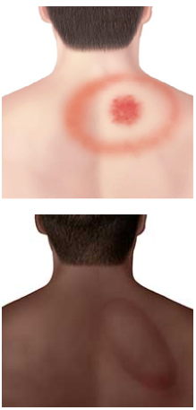
How will I know if I have Lyme disease?
Many people who have Lyme disease get a rash that looks like a bulls-eye or a target.
If you get sick from a tick bite, you may also get:
Sore muscles
Very tired
Fever or chills
Headache
If you’ve been in a place where ticks live and you don’t feel well, tell an adult. They’ll speak to a doctor to see if you need medicine.
Images courtesy of the CDC
Notes:
How will I know if I have Lyme disease?
Many people who have Lyme disease develop a bulls-eye or target shaped rash.
However, not everyone gets the rash.
If you get sick from a tick bite, you may also get:
Sore muscles
Very tired
Fever or chills
Headache
If you’ve been in a place where ticks live and don’t feel well, tell an adult. They’ll speak to a doctor to see if you need medicine.
Many other illnesses, including other diseases spread by ticks, may also have similar symptoms, which is why it’s important to talk to a doctor.

Slide 15
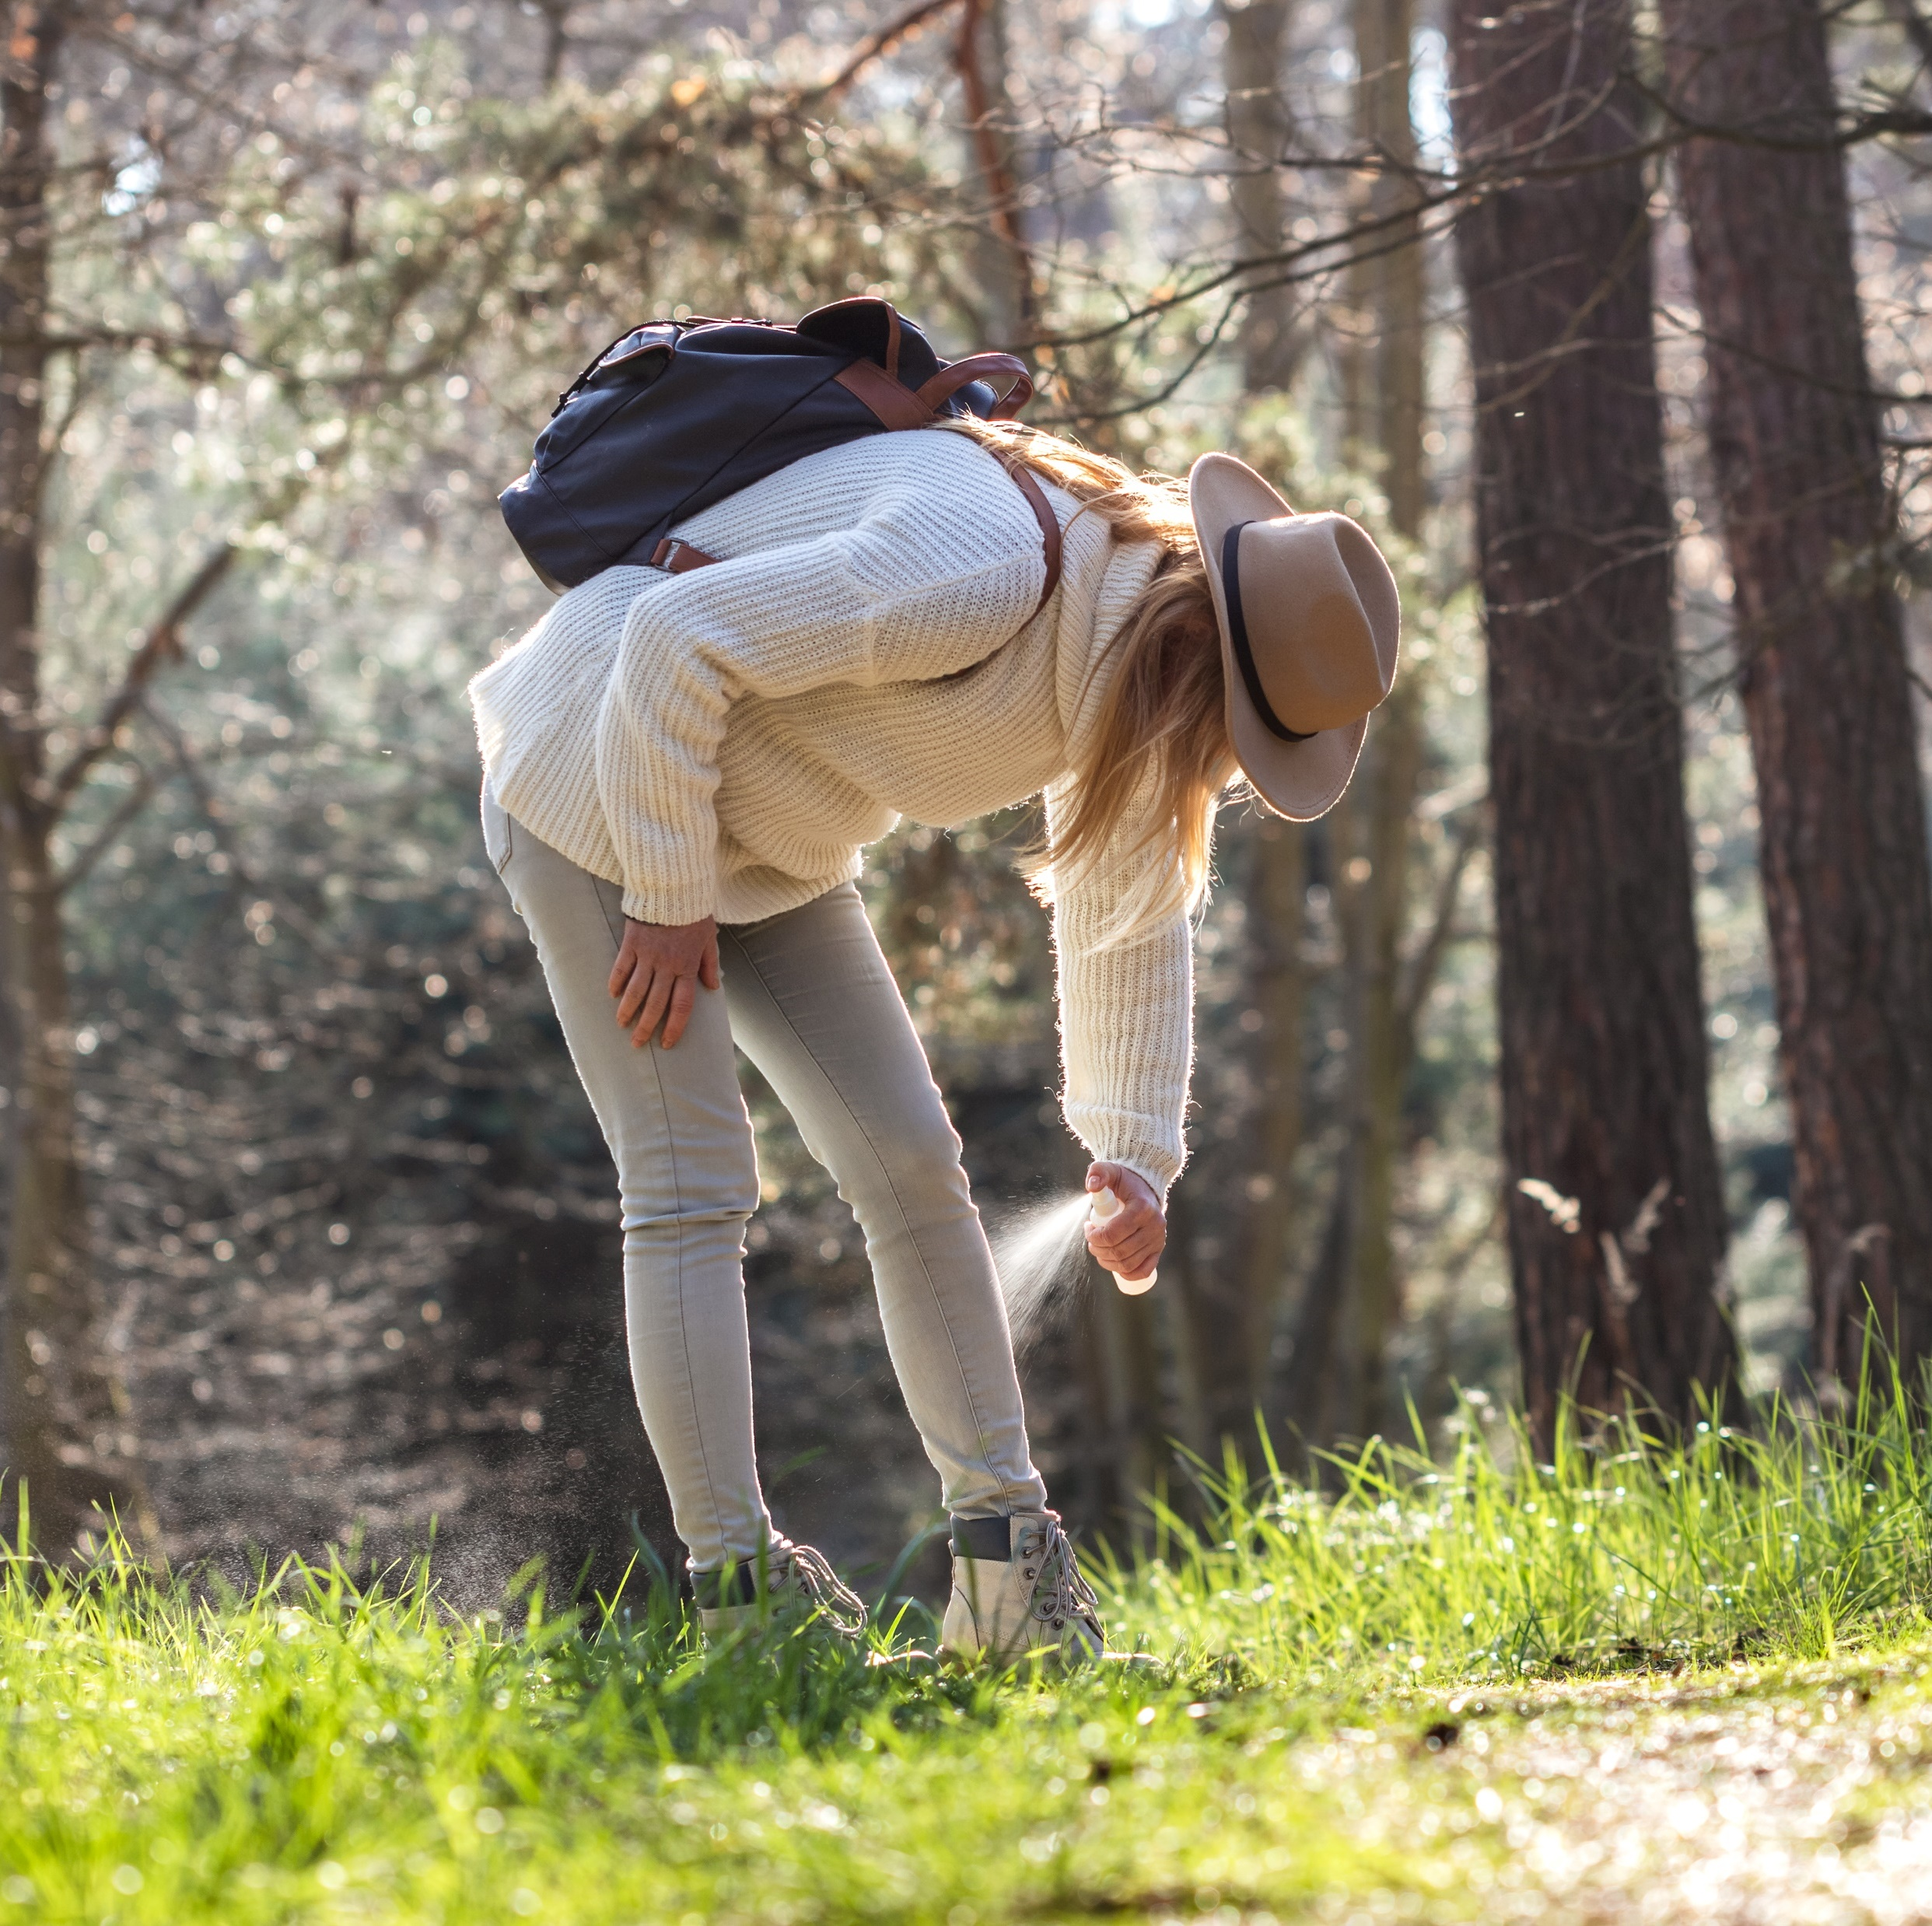
How can I prevent tick bites?
When in tick habitat:
Wear repellent that can repel ticks.
Cover your body by wearing long pants and tuck them into your socks.
Wear light-colored clothing to see any crawling ticks.
Notes:
When in tick habitat:
Wear repellent that can repel ticks.
Tick repellent will help repel mosquitoes too.
Wear long pants and tuck them into your socks.
Wear light-colored clothing to see any crawling ticks
If there is a tick crawling on you, brush it off right away.
[3-DP 1.2] Ways to prevent illness.

Slide 16
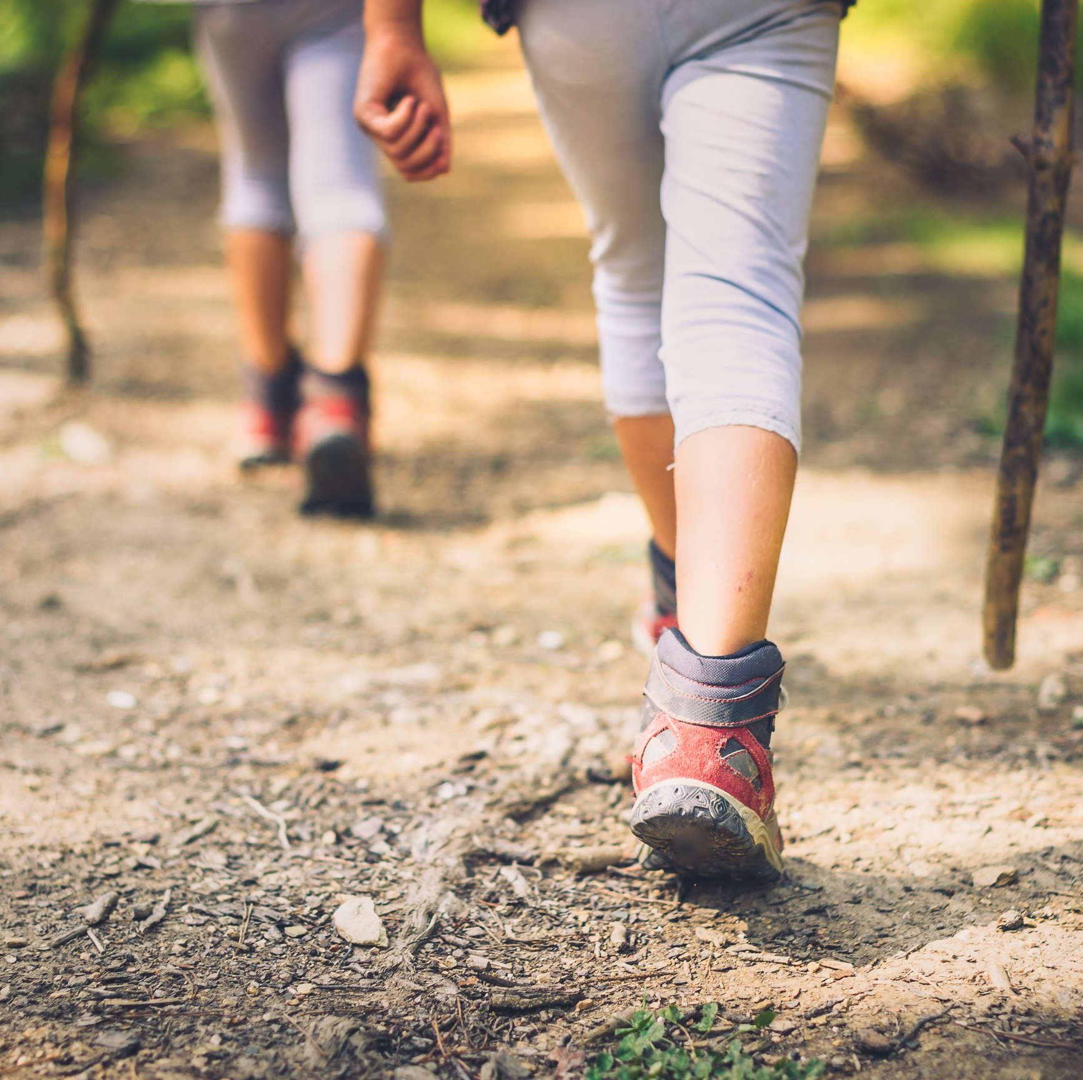
How can I prevent tick bites?
When in tick habitat (continued):
Avoid tall grass, bushes, and piles of dead leaves.
If hiking, stay in the center of clear paths.
Notes:
When in tick habitat (continued):
Avoid tall grass, bushes, and piles of dead leaves.
If hiking, stay in the center of clear paths.

Slide 17

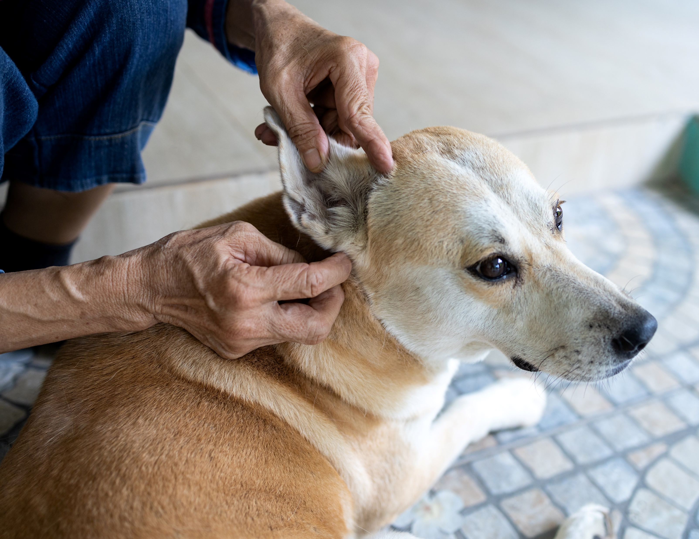
How can I prevent tick bites?
After returning home:
Take a shower or bath soon after coming indoors.
Do a tick check on yourself and pets.
Ask an adult to help remove any ticks that you may find.
Notes:
After returning home:
Take a shower or bath soon after coming indoors.
Do a tick check on yourself and pets.
Ask an adult to help remove any ticks that you may find.

Slide 18
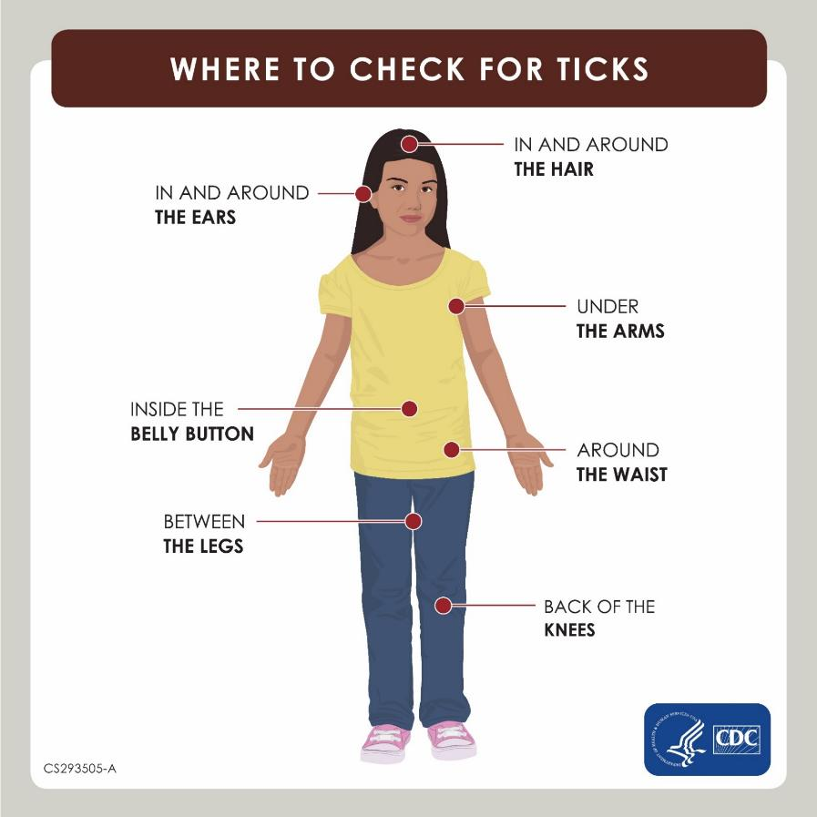
Class Activity Do a Tick Check
Carefully inspect your body, feeling for any bumps or noticing any unusual marks.
Remember, ticks are tiny and easy to miss!
Ask a parent to check for ticks on you, especially in places that are hard to see.
If you find a tick, ask an adult to help you remove it.
Image courtesy of the CDC
Notes:
Do a Tick Check:
Carefully inspect your body, feeling for any bumps or noticing any unusual marks.
Remember, ticks are tiny and easy to miss!
Ask a parent to check for ticks on you, especially in places that are hard to see.
If you find a tick, ask an adult to help you remove it.
Model a tick check on your self and have the class stand up and follow along.
Have everyone carefully feel their bodies for any odd bumps that might potentially be a tick.
Work carefully and slowly from top to bottom, starting with the hairline and checking in all joint areas and skin folds.
Inform students that going to the bathroom or taking a shower or bath is a great time to check for ticks between the legs and other parts of the body.
[3-PHS 7.1] Demonstrate safety and injury prevention practices and behaviors.

Slide 19
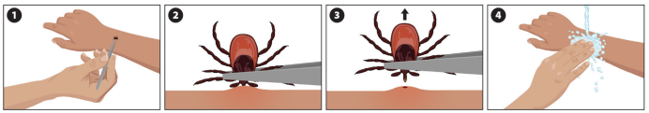
Removing a tick
If you find a tick, tell an adult right away. They will remove the tick for you using tweezers.
Removing a tick usually does not hurt, but the skin where the tick was attached might have a red bump.
If you have a rash or do not feel well a few days after removing a tick, tell an adult.
Use tweezers to grab the tick near the skin.
Pull up gently and evenly. Don’t twist or jerk the tick.
After the tick comes off, clean the bite area and your hands with soap and water.
Image courtesy of the CDC.
Notes:
If you find a tick, tell an adult right away. They will remove the tick for you using tweezers.
Removing a tick usually does not hurt, but the skin where the tick was attached might have a red bump.
If you have a rash or do not feel well a few days after removing a tick, tell an adult.
Use tweezers to grab the tick near the skin.
You want to grab the tick as close as you can to the mouth.
Pull up gently and evenly. Don’t twist or jerk the tick
After the tick comes off, clean the bite area and your hands with soap and water.
If you would like to bring the tick to your doctor for identification, place it in a sealed bag or small container of alcohol or hand sanitizer. Otherwise, flush it down the toilet.
Do not use petroleum jelly, a hot match, nail polish, or other products to remove the tick. Your goal is to remove the tick as quickly and safely as possible.

Slide 20

Class Activity
10
mins
Tick Check Harry
Instructions
Check for ticks on Harry. Gently, run your hands through his fur to feel for any “ticks.”
Mark where you found the ticks on your handout. Leave the ticks on for the next person to check.
Pass Harry to the next person.
Notes:
It is also important to check pets for ticks. Here, we’re going to practice checking for ticks on Tick Check Harry. Harry recently spent some time running around and we need to check him for ticks. Don’t worry, Harry is a fake dog and the ticks on him are fake.
In your groups:
Check for ticks on Harry. Gently, run your hands through his fur to feel for any “ticks.” Handle Harry with care, just like a real dog!
Mark where you found the ticks on your handout. Leave the ticks on for the next person to check.
Pass Harry to your next classmate.
[3-PHS 7.1] Demonstrate safety and injury prevention practices and behaviors.

Slide 21
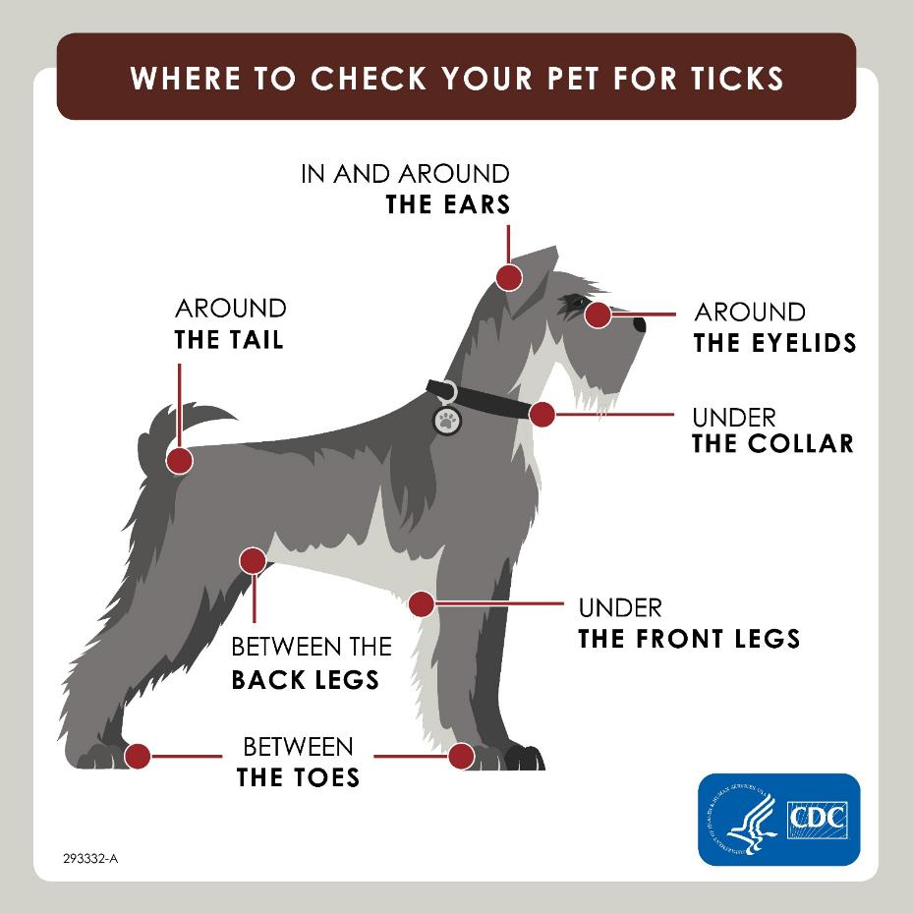
Image courtesy of the CDC
Notes:
Use the graphic as reference for common places ticks like to hide on dogs. Leave this slide up during the activity for students to reference.

Slide 22
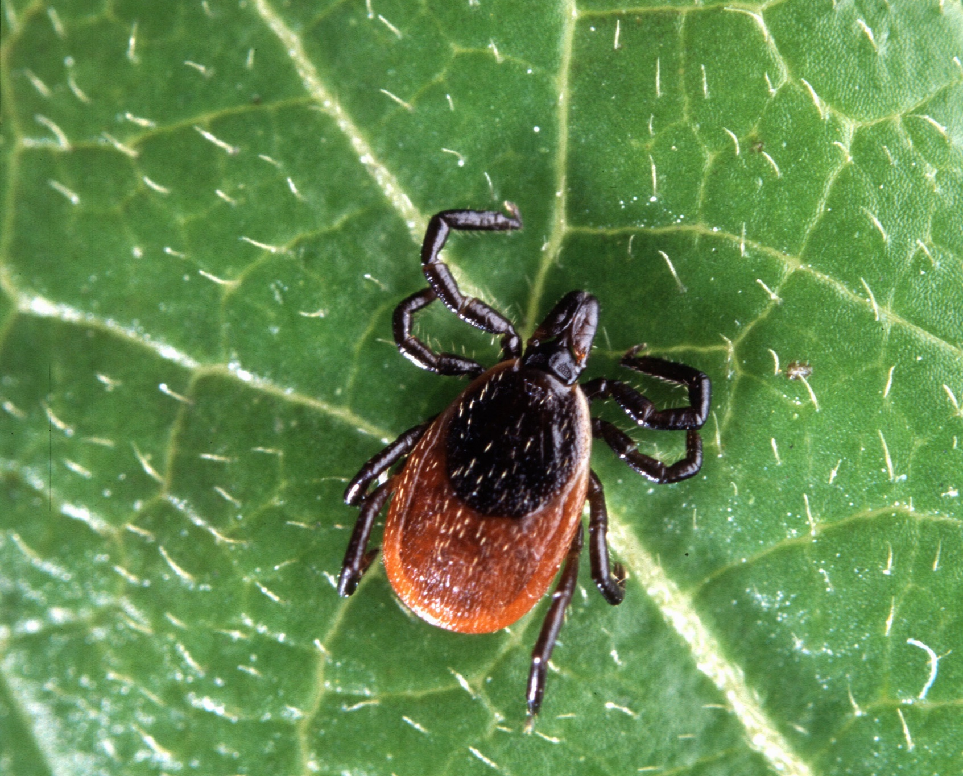
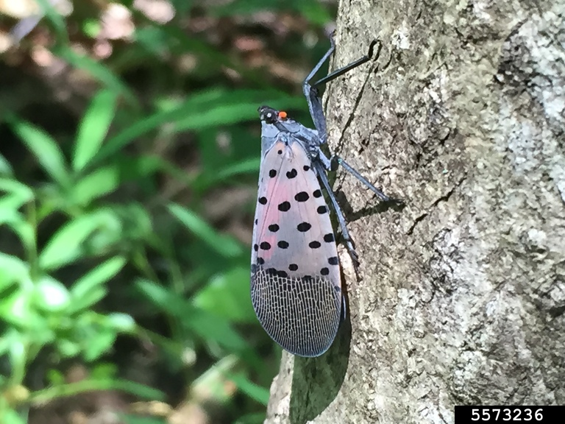
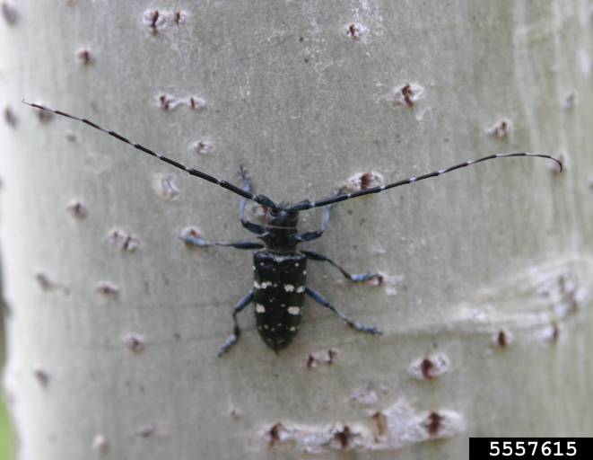
Review
Which one is a tick? How do you know?
Blacklegged tick
Spotted lanternfly
Asian longhorned beetle
Images courtesy of: (left to right) Scott Bauer, USDA Agricultural Research Service, Bugwood.org; Emelie Swackhamer, Penn State University, Bugwood.org; Gillian Allard, FAO of United Nations, Bugwood.org
Notes:
Which one is a tick? How do you know?
Ask students to describe. Answers may include:
They have 8 legs (except for larvae, which have 6 legs)
Ticks have no antennae
Ticks have no wings

Slide 23
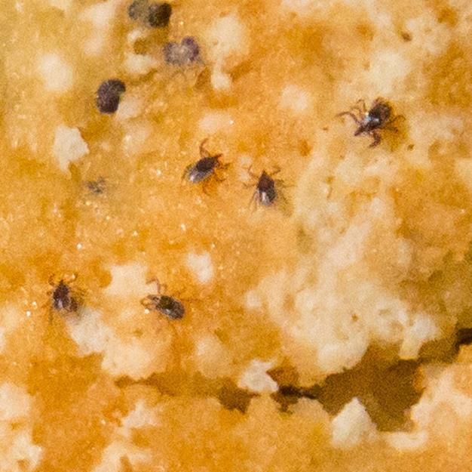

Review
How big are ticks?
Image courtesy of the CDC, James Gathany
Notes:
How big are ticks?
Very tiny! They can be as small as a poppy seed.

Slide 24


Review
Will you always get sick from being bit by a tick?
No, only if that tick has germs and was attached for a long enough time.
What should you do if you don’t feel well after spending time in areas where ticks live?
Tell an adult and see a doctor.
Notes:
Will you always get sick from being bit by a tick?
No, only if that tick has germs and was attached for a long time.
What should you do if you don’t feel well after spending time in areas where ticks live?
Tell and adult and see a doctor.
[4-DP 8.1] Give factual information to improve the personal health and wellness of others.

Slide 25
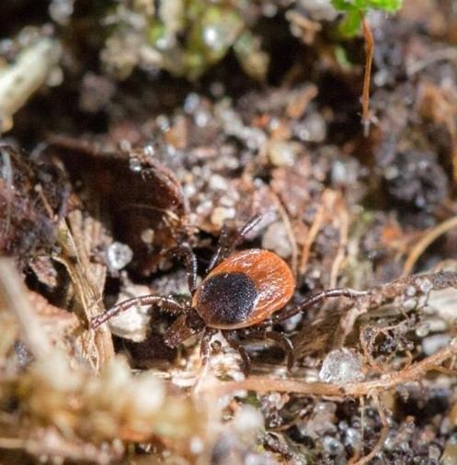



Review
In which habitat would you take actions to protect yourself from ticks?
Forest image and tick in leaf litter image courtesy of the Minnesota Department of Health.
Notes:
In which habitat would you take actions to protect yourself from ticks?
Ticks live in tall grass, woods, and bushes. They can also be found in leaf litter. Ticks prefer shade and avoid the sun.
Although ticks can be found in NYC, especially in Staten Island and the north Bronx, they need habitat with lots of greenery. They often live in the same places where one of their favorite host animals – deer, live.
[3-DP 5.1] Use a decision-making process to reduce the risk of communicable disease or illness.
[5-DP 5.1] Apply a decision-making model to real-life health-related situations.

Slide 26

Review
When spending time in areas where ticks may live, what can you do to prevent ticks?
Wear repellent that can repel ticks.
Wear light-colored clothing to more easily see any crawling ticks.
Take a shower or bath soon after coming indoors.
Do a tick check.
Notes:
When spending time in areas where ticks may live, what can you do to prevent ticks?
Wear repellent that can repel ticks.
Wear light-colored clothing to more easily see any crawling ticks
Take a shower/bath soon after coming indoors
Do a tick check
[3-DP 5.1] Use a decision-making process to reduce the risk of communicable disease or illness.
[5-DP 7.1] Identify at least three ways they will help protect their bodies against germs and disease.

Slide 27
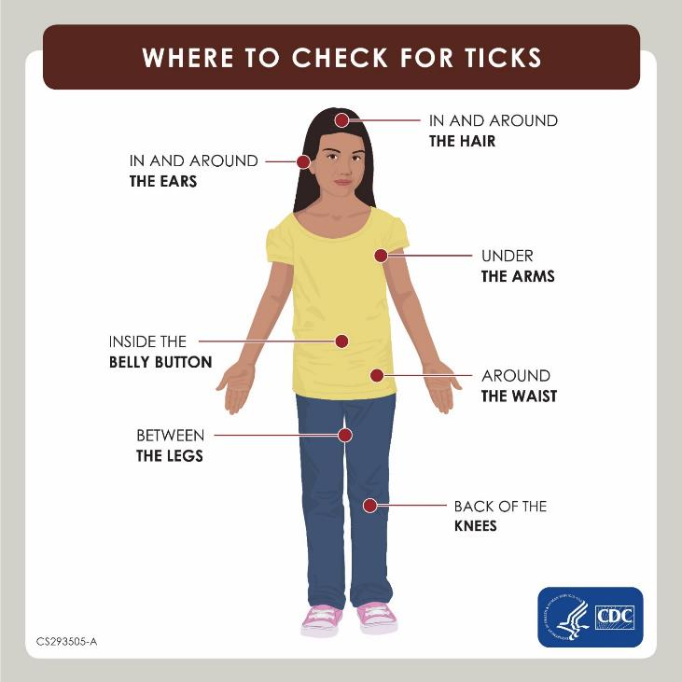
Review
Where on our bodies should we check for ticks?
In and around the ears
Back of the neck
In the hairline
Armpits
Belly buttons
Between the legs
Back of the knees
Image courtesy of the CDC
Notes:
Where on our bodies should we check for ticks?
In and around the ears
Back of the neck
In the hairline
Armpits
Belly buttons
Between the legs
Back of the knees
[3-PHS 7.1] Demonstrate safety and injury prevention practices and behaviors.

Slide 28
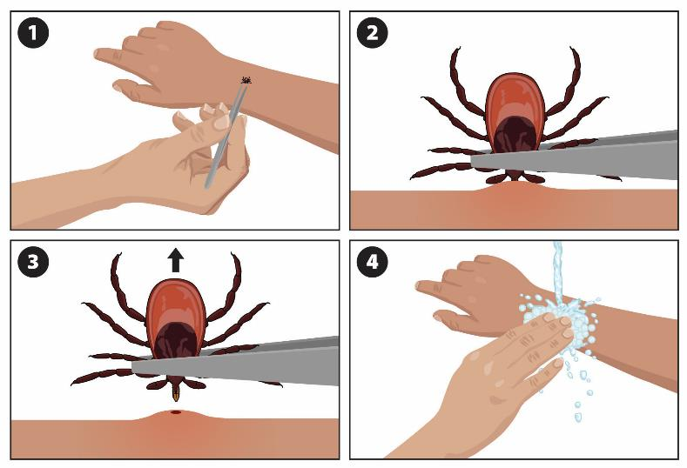
Review
What should you do when you find a tick on you?
Image courtesy of the CDC
Notes:
What should you do when you find a tick on you?
Ask an adult to remove the tick using tweezers.
Your goal is to remove the tick as quickly and safely as possible.

Slide 29
Thank you!
Special thanks to:
Centers for Disease Control and Prevention
Maine Center for Disease Control and Prevention
Minnesota Department of Health
New York State Department of Health
Notes:
[4-DP 3.1] Demonstrate how to locate sources of accurate personal health and wellness information.

Slide 30
Questions?
For more information, visit health.nyc.gov/ticks.
Zoonotic & Vector-borne Disease Unit
ZIVDU@health.nyc.gov

